Slide 1
Salt Lake City, UT
Notes:
It was a clear, sunny day in March of 2012.
Craig Dietrich wiped the crumbs from his fingers before answering the phone in his Salt Lake City office. It was lunch-time, but as usual Craig sat at his desk, working, & eating the sandwich he had packed the night before.
When he heard the voice of the Department’s Deputy Director, he sat up a little straighter.
The US Centers for Disease Control & Prevention (CDC) just called the UT Department of Health. . .they were concerned after hearing from a local health clinic that people in UT had thallium poisoning.
[Photo: http://www.flickr.com/photos/utahimages/6326105264/ ]

Slide 2
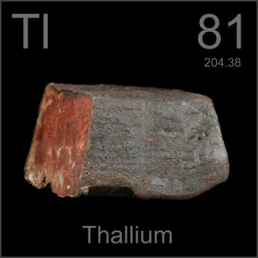
Notes:
Thallium, a bluish-white metal, is found in trace amounts in the earth's crust. The colors here result from layers of thallium oxide. In its pure form, thallium is odorless and tasteless.
It’s used mostly in electronic manufacturing. In the past, it was obtained as a by-product from smelting other metals; however, it has not been produced in the United States since 1984.
Because it’s odorless and tasteless and because it is toxic, thallium was used in a few murders before people caught on to its characteristic symptoms, which includes hair loss, nausea, and numbness in the fingers & toes.
As a toxicologist, Craig knew much of this but couldn’t imagine why folks in UT would be poisoned. It takes a lot of thallium to develop these symptoms. And by the time someone has these symptoms, Craig says, there is not a lot of hope for recovery.
[Photo: http://periodictable.com/Elements/081/]

Slide 3
Traverse Mountain, UT
Notes:
In his typically methodical way, he began to collect more information.
He found out that during routine testing, a new well (connected to the drinking water distribution system in Traverse Mountain) was found to be contaminated with thallium.
Traverse Mountain is a relatively new incorporated area not far from Salt Lake City.
[Photos: http://www.zillow.com/homedetails/Traverse-Mountain-Lehi-UT-84063/2146968102_zpid/ and http://www.ballventures.com/property/lehi-pointe-lehi-utah.html ]

Slide 4
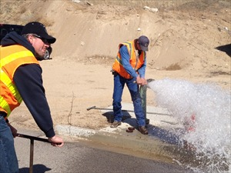
Notes:
The well was disconnected and the pipes were flushed, but the flushing caused more thallium to come out of the pipes, causing huge spikes of the contaminant in the drinking water.
The water department sent a notice to drinking water recipients telling them of the situation.
The flushing continued for weeks before the thallium fell back to background levels.
[Photo: http://www.abc4.com/content/news/top_stories/story/Traverse-Mountain-residents-say-theyve-been/VRXQVtLZJ0WM2GjqyWnvqA.cspx]

Slide 5
Notes:
Needless to say the media covered the story. . .and it just so happened that around the same time a local health clinic saw a few patients with odd symptoms.
The health clinic director worried the symptoms might be connected to the exposure and called the CDC’s Emergency Operations Center.
This brings our story back to Craig, whose lunch was so abruptly cut short. Given the symptoms, Craig felt fairly certain that the patients were not suffering from thallium poisoning.
As a toxicologist, Craig lives by the idea that the “dose makes the poison”, so he turned his attention to doing a dose reconstruction to figure out how much thallium people had absorbed over time. This was important because testing for thallium only occurs every three years and residents worried that they had been chronically exposed over the last three years. Fortunately, the doses were low enough not to be a concern toxicologically.
Citizens were also upset about potential thallium-contaminated soil being used for gardens & vegetation, especially since they use untreated water for watering gardens. So Craig called the Utah Unified State Laboratories to do additional testing on the soil.

Slide 6
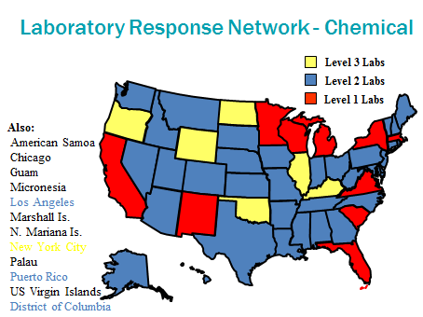
Notes:
Specifically, he contacted Dr. Sanwat Chaudhuri, a petite, soft-spoken chemist, who agreed to help immediately.
Fortunately, her laboratory had strong capabilities for analyzing elements due to funding from CDC for emergency preparedness & response. As a level two lab in the Laboratory Response Network, UT owns two Inductive Coupling Plasma- Mass Spectrometers (ICP-MS for short).
This equipment can be used to test not only for agents of chemical terrorism, but also for everyday metals that might lead to public health concerns, such as thallium.

Slide 7
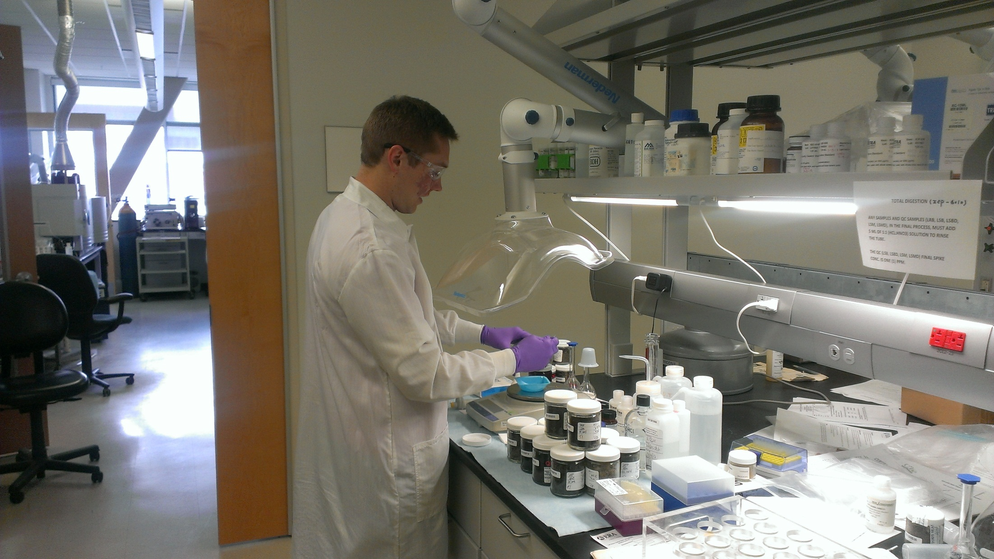
Notes:
Sanwat told Craig that there was only one problem: the level of thallium expected was lower than what the lab typically looked for. Luckily, the lab had the expertise to detect the lower detection limits expected in these samples.
Lab scientists worked on validating the desired low detection level, while Craig scheduled sample collection dates with the residents of Traverse Mountain.
Ultimately, the lab tested soil samples from 15 locations in Traverse Mountain. Laboratorians analyzed soil that was possibly contaminated, as well as soil that was not contaminated, in order to compare thallium levels.
Using the data generated from the lab, Craig was able to conclude that the soil did not pose a health hazard to the community.

Slide 8
So what?
Public health laboratories protect our health through the monitoring of our drinking water.
Notes:
Experts say when telling stories, you need to remember your audience is probably asking “So what?”
So here’s the what:
Overall, over 5700 people were impacted by the contaminated drinking water.
Without government regulation and monitoring, this issue would not have been discovered.
Using laboratory results and the principles of toxicology, Craig (& the UT Department of Health) was able to answer the questions of the community. . . and most importantly, to calm their fears.
This is only one of many examples of how PHLs keep our population healthy & productive.
[click]
So here is the message: Public health laboratories protect our health through the monitoring of our drinking water. . . Go visit your PHL. Listen to their stories.

