Slide 1
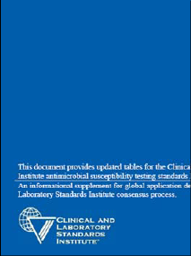
Navigating the 2012 Changes to CLSI M100, M02 and M07
Raymond P. Podzorski, Ph.D, D(ABMM)
Clinical Microbiologist
ProHealth Care Laboratories
M100-S22
May 10, 2012
M07-A9
M02-A11

Slide 2
CLSI
Clinical and Laboratory Standards Institute (CLSI) is an international, interdisciplinary, nonprofit, standards developing, and educational organization that promotes the development and use of voluntary consensus standards and guidelines within the health care community.
Center for Medicare & Medicaid Services (CMS) (via CLIA) incorporates many CLSI susceptibility standards and guidelines into their Regulations and Interpretive Guidelines for Laboratories and they can be found under Standard 493.1261: Bacteriology

Slide 3
All Updated in 2012
M100 Performance Standards For Antimicrobial Susceptibility Testing – Updated at least Yearly (updated 2X in 2010)
M02 Performance Standards for Antimicrobial Disk Susceptibility Tests (Ref. Method) – Updated every 3 years
M07 Methods for Dilution Antimicrobial Susceptibility Tests for Bacteria that Grow Aerobically (Ref. Method) – Updated every 3 years

Slide 4
Major CLSI Changes in 2012
Enterobacteriaceae M100-S22
Revised breakpoints for ertapenem
Added ciprofloxacin breaks points for use with S. typhi and extraintestinal
isolates of Salmonella spp.
Pseudomonas aeruginosa M100-S22
Revised breakpoints for piperacillin, piperacillin-tazobactam, ticarcillin,
tarcarcillin-clavulanic acid, imipenem, and meropenem
Added breakpoints for doripenem
Staphylococcus spp. M100-S22, M02-A11, and M07-A9
Added penicillin disk zone edge test for β-lactamase production in S. aureus

Slide 5
Why the Breakpoint δ?
CLSI does a reassessment of interpretive criteria when new information concerning antimicrobial resistance becomes available.
The CLIS breakpoints are revised to correspond to how particular antibiotics work in treating infections with today’s bacteria.

Slide 6
Enterobacteriaceae
Revised ertapenem breakpoints
Added ciprofloxacin breakpoints for
use with S. typhi and extraintestinal
isolates of Salmonella spp.

Slide 7
Enterobacteriaceae
Ertapenem
CLSI Document | MIC (µg/ml) |  |  | Disk Diffusion (mm)
 | Suscep | Int | Res | Suscep | Int | Res
M100-S19 2009 | ≤2 | 4 | ≥8 | ≥19 | 16-18 | ≤15
M100-S20 2010 | ≤2 | 4 | ≥8 | ≥19 | 16-18 | ≤15
M100-S20U 2010 | ≤0.25 | 0.5 | ≥1 | ≥23 | 20-22 | ≤19
M100-S21 2011 | ≤0.25 | 0.5 | ≥1 | ≥23 | 20-22 | ≤19
M100-S22 2012 | ≤0.5 | 1 | ≥2 | ≥22 | 19-21 | ≤18

Slide 8
Why did CLSI Revise Ertapenem Breakpoints Twice in 2 Years?
The June 2010 Ertapenem breakpoints for Enterobacteriaceae were based primarily on PK/PD review, MIC distributions from limited clinical data with no MICs at 0.5 µg/ml
So a conservative ≤0.25 µg/ml cutoff for susceptibility was chosen for June 2010
The January 2012 Ertapenem breakpoints for Enterobacteriaceae were based on further PK/PD review, additional MIC distributions from additional clinical data with MICs of 0.5 µg/ml not having carbapenemases, AND because the lowest concentration on some commercial panels is 0.5 µg/ml thus making it possible to use the 2012 CLSI Ertapenem breakpoint if they wanted to do the verification

Slide 9
What About ESBL or Carbapenemase Screening and Confirmation?
IF Using FDA Breakpoints
IF Using CLSI Breakpoints
No ESBL Screen or
Carbapenemase screen
Needed Report S/I/R ± MIC
If requested for Infection
Control purposes
Screen for ESBL or
Carbapenemase -
If Positive
Perform ESBL or MHT
Confirmation
Perform ESBL or MHT
Screen and Confirmation
Confirmation positive –
Report M100-S19

Slide 10
FDA Breakpoints

Slide 11
Enterobacteriaceae
CLSI M100-S22
Extraintestinal isolates of Salmonella spp. and Salmonella typi
New ciprofloxacin breakpoints specific for
extraintestinal Salmonella spp. and for all isolates of
Salmonella typhi

Slide 12
S. Typhi and extraintestinal Salmonella spp.
Table 2A Enterobacteriaceae Ciprofloxacin and Levofloxacin Breakpoints
Antibiotic | Old M100-S21 Extraintes. Test FQ and NalA |  |  | New M100-S22 Extraintes. And S. typhi
 | Suscep* | Int* | Res* | Suscep | Int | Res
Cipro | 1 | 2 | 4 | 0.06 | 0.12-0.5 | 1
Levo | 2 | 4 | 8 | - | - | -
* µg/ml
Disk diffusion breakpoints also revised

Slide 13
Pseudomonas aeruginosa
CLSI M100-S22
Lowered breakpoints for piperacillin, ticarcillin, piperacillin-
tazobactam, and ticarcillin-clavulanic acid
Lowered breakpoints for imipenem, and meripenem
Added breakpoints for doripenem

Slide 14
Pseudomonas aeruginosa
Antibiotic | M100-S21 - 2011 |  |  | M100-S22 - 2012
 | Suscep* | Int* | Res* | Suscep | Int | Res
Piperacillin | ≤64 | - | ≥128 | ≤16 | 32-64 | ≥128
Ticarcillin | ≤64 | - | ≥128 | ≤16 | 32-64 | ≥128
Pip/Tazo | ≤64/4 | - | ≥128/4 | ≤16/4 | 32/4-64/4 | ≥128/4
Ticar/Clav | ≤64/2 | - | ≥128/2 | ≤16/2 | 32/2-64/2 | ≥128/2
* µg/ml
Disk diffusion breakpoints also revised

Slide 15
Pseudomonas aeruginosa
Antibiotic | M100-S21 - 2011 |  |  | M100-S22 - 2012
 | Suscep* | Int* | Res* | Suscep | Int | Res
Imipenem | ≤4 | 8 | ≥16 | ≤2 | 4 | ≥8
Meropenem | ≤4 | 8 | ≥16 | ≤2 | 4 | ≥8
Doripenem | - | - | - | ≤2 | 4 | ≥8
* µg/ml
Disk diffusion breakpoints also revised

Slide 16
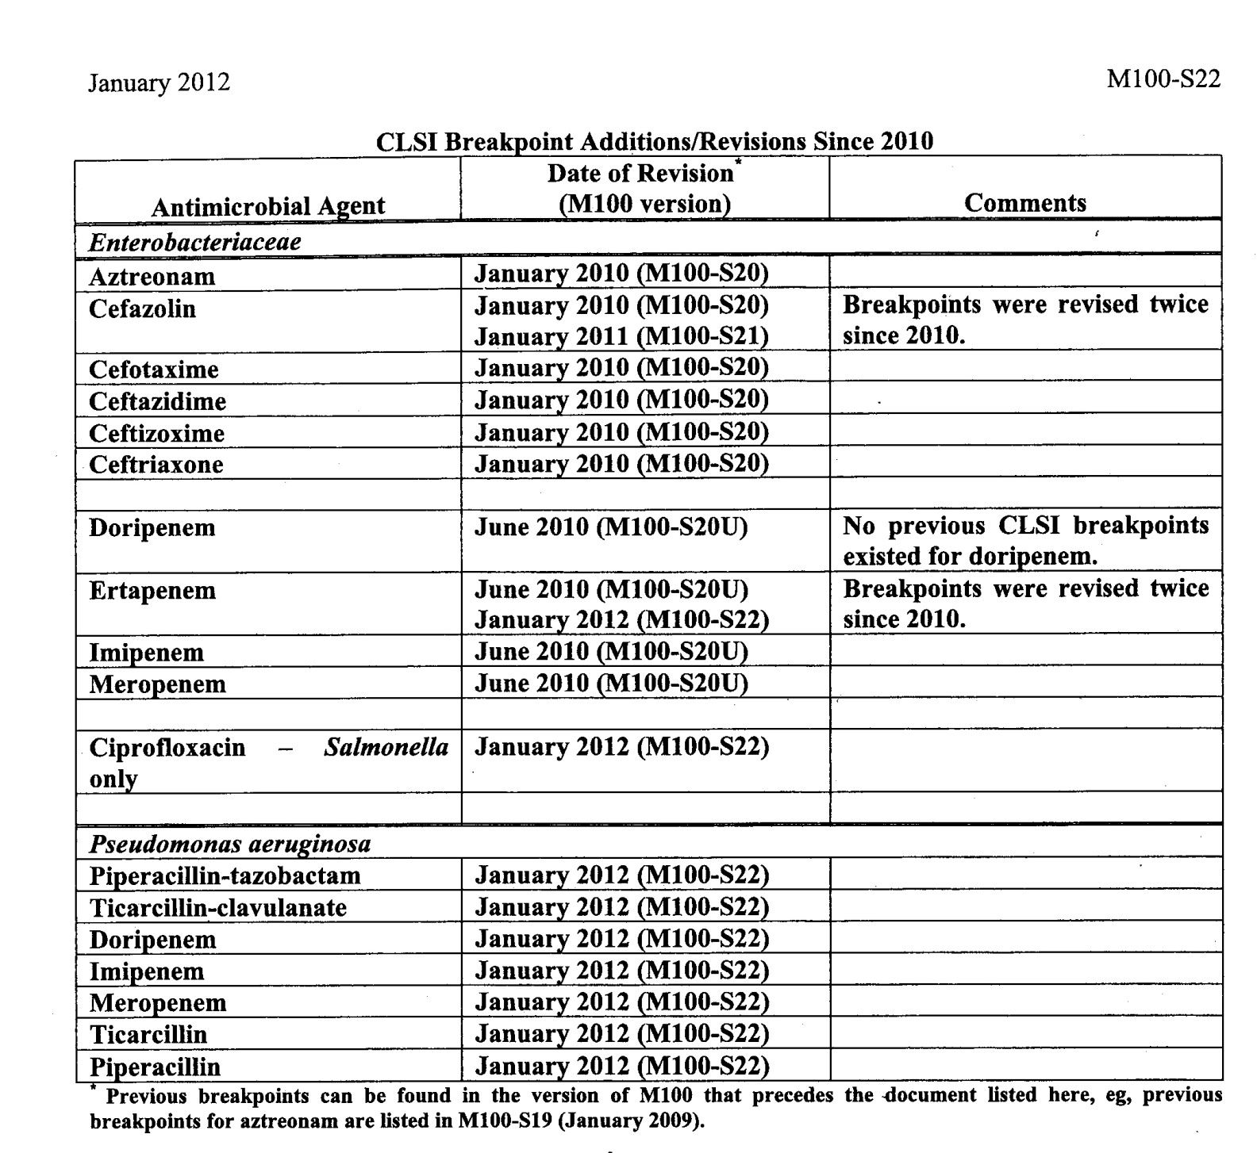
Antibiotic Breakpoint changes since 2010

Slide 17
Breakpoint Facts
Both the FDA and CLSI set breakpoints for USA
Commercial AST systems (Vitek, Microscan, etc.)
must use FDA breakpoints
Clinical Laboratories can use either FDA or CLSI
breakpoints
On commercial AST systems, the CLSI
breakpoints that differ from the FDA breakpoints
must be verified on the system prior to using
them

Slide 18
IMPORTANT POINT!
Manufacturers of antimicrobial reagents and devices cannot change their device or system breakpoints for a specific antibiotic until the manufacturer of the antibiotic changes the breakpoints in the product insert at the direction of the FDA .

Slide 19
CLSI 2012
R I S
≤19 20-22 ≥23
≤17 18-20 ≥21
≤19 20-22 ≥23
≤18 19-21 ≥22
≤19 20-22 ≥23
Same for Etest Stripts

Slide 20
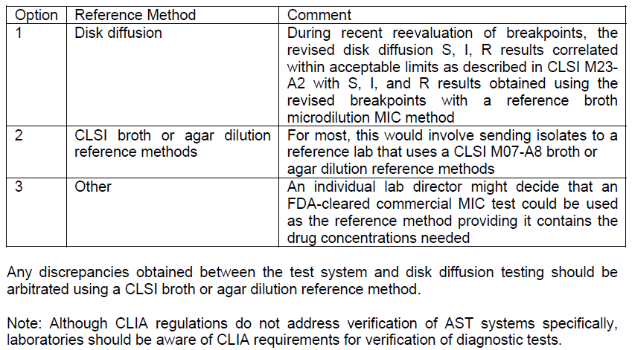

Slide 21
CAP BIT

Slide 22
Reporting of Isolates Resistant to All Antibiotics Tested
M100-S22, page 25-26
Instructions for Use of Tables 1 and 2
I. Selecting Antimicrobial Agents for Testing and Reporting
D. Selective Reporting
“….each laboratory should develop a protocol to address isolates that are confirmed as resistant to all agents on their routine test panels. This protocol should include options for testing additional agents in-house or sending the isolate to a reference laboratory.”
CAP MIC.21944

Slide 23
Urine - >100,000 cfu/ml, Proteus mirabilis, Severe UTI
Antibiotic Interpretation
Antibiotic Interpretation
A/S R
AK R
AM R
AUG R
CAX R
CFG R
CP R
CPE R
CRM R
ETP R
FD R
GM R
IMP R
LVX R
MER R
P/T R
TE R
TIM R
TO R
Confirm antibiotic phenotype
Have a procedure in place to deal with this situation
MIC.21944 Supplemental Antimicrobial Agents Phase I
There are protocols for testing supplemental agents on isolates resistant to routinely tested antimicrobial agents, as needed.
NOTE: The protocol may include submission of isolates to an outside reference laboratory if testing is not performed onsite.

Slide 24
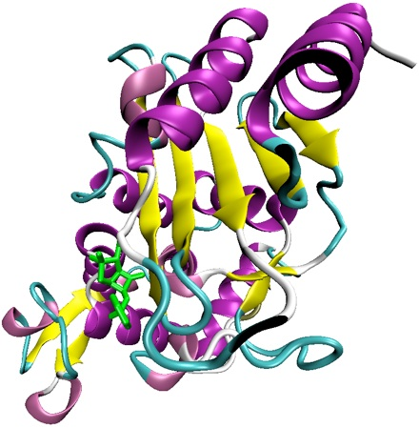
S. aureus β-lactamase Testing

Slide 25
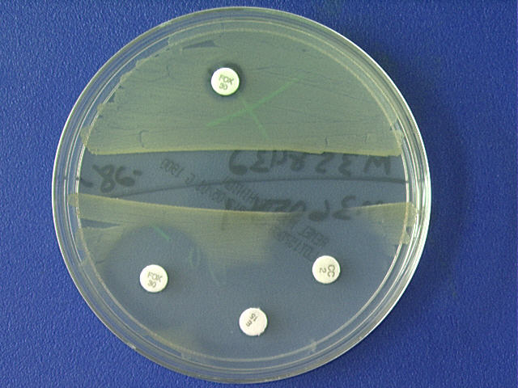
Induced β-lactamase test
Incubate at RT
For 1 hour
MHA
BAP

Slide 26
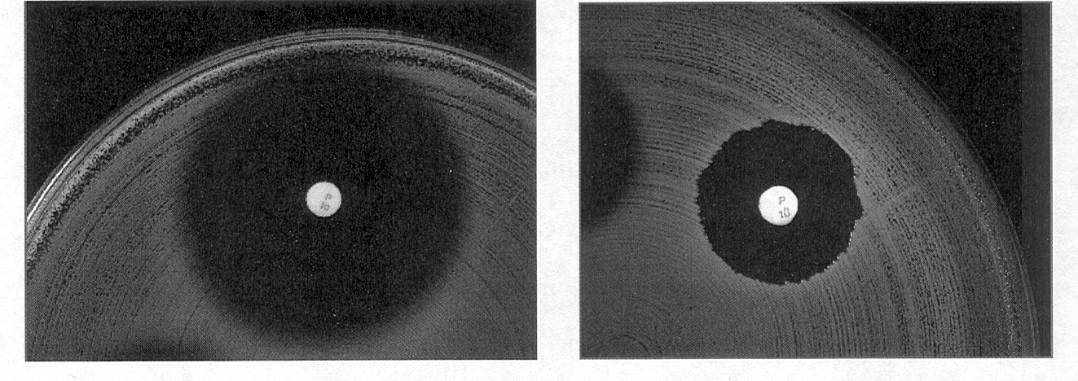
Penicillin disk “zone edge test” for β-lactamase production in S. aureus
Negative for β-lactamase production
“Fuzzy” zone edge (beach)
Positive for β-lactamase production
“sharp” zone edge (cliff)
10 U penicillin disk and standard Kirby-Bauer disk diffusion method
QC: S. aureus ATCC 29213 positive
S. aureus ATCC 25923 negative
Induced Cefinase test – sensitivity 75%; specificity 100%
Zone edge test – sensitivity 96%; specificity 100%

Slide 27
S. aureus Penicillin Reporting
S. aureus isolate
Determine
Pen MIC
Pen MIC
≥ 0.25
Pen MIC
≤ 0.12
Drop Disks
FOX, E, CC, P
D-test?
Zone Edge
Pen
Resistant
Report Pen
S/R
Overnight Incubation

Slide 28
S. aureus Penicillin Reporting
S. aureus isolate
Determine
Pen MIC
Pen MIC
≥ 0.25
Pen MIC
≤ 0.12
Pen
Resistant
Cefinase
Positive -Resistant
Negative
Zone-Edge
Overnight Incubation
Overnight Incubation

Slide 29
Penicillin disk “zone edge test” for β-lactamase production in S. aureus
Negative for β-lactamase production
“Fuzzy” zone edge (beach)
Positive for β-lactamase production
“sharp” zone edge (cliff)
Zone edge β–lactamase test ONLY for S. aureus that test Susceptible!

Slide 30
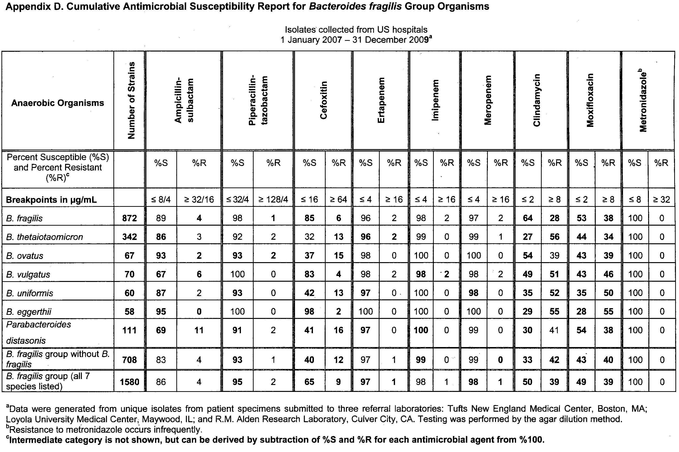
Anaerobe Suscep. Table

Slide 31
M02-A11 and M07-A9 2012
Both Updated for 2012
M02 Performance Standards for Antimicrobial Disk Susceptibility Tests (Ref. Method) – Updated every 3 years
M07 Methods for Dilution Antimicrobial Susceptibility Tests for Bacteria that Grow Aerobically (Ref. Method) – Updated every 3 years

Slide 32
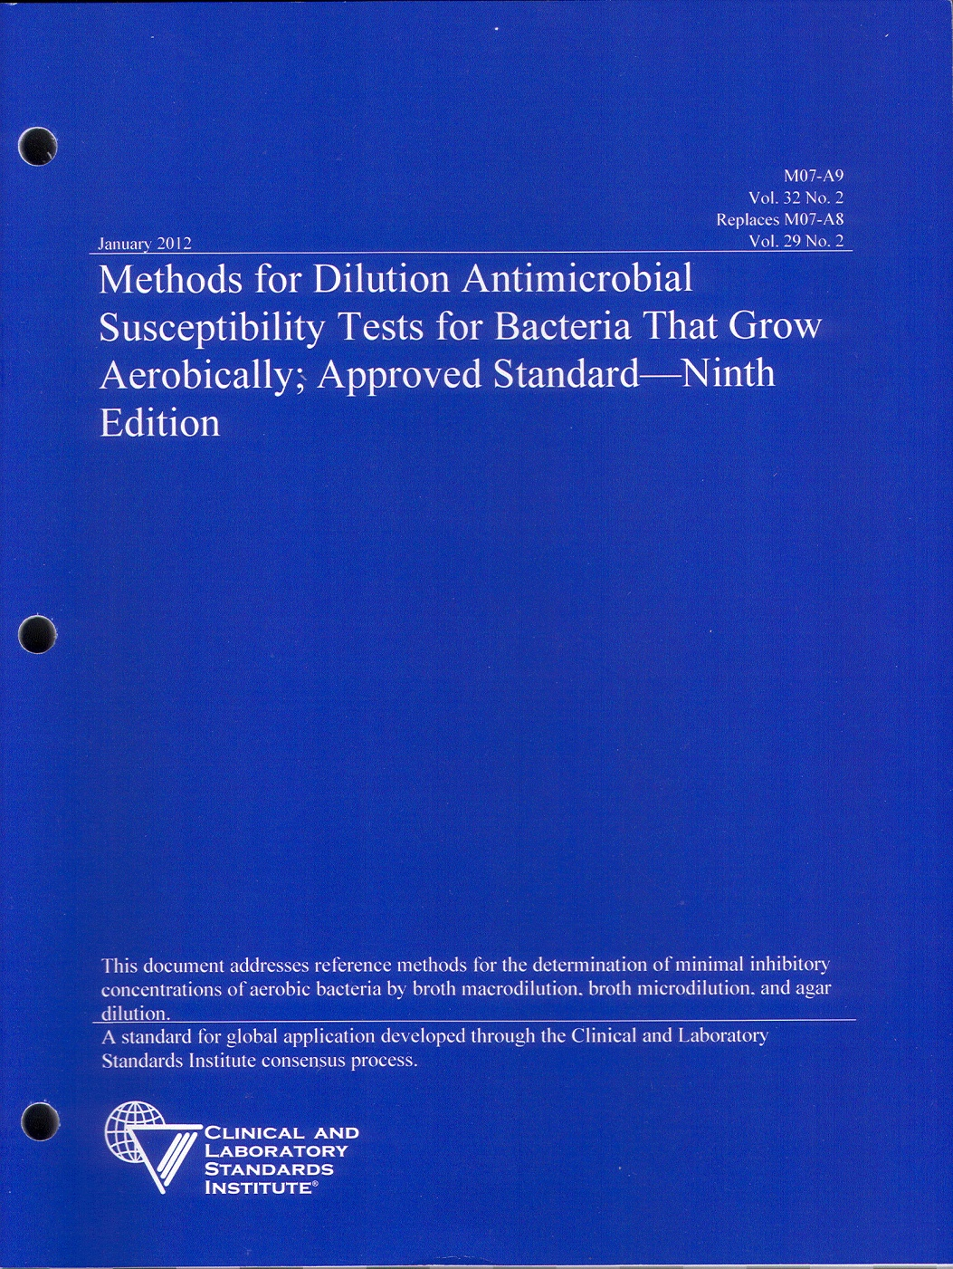
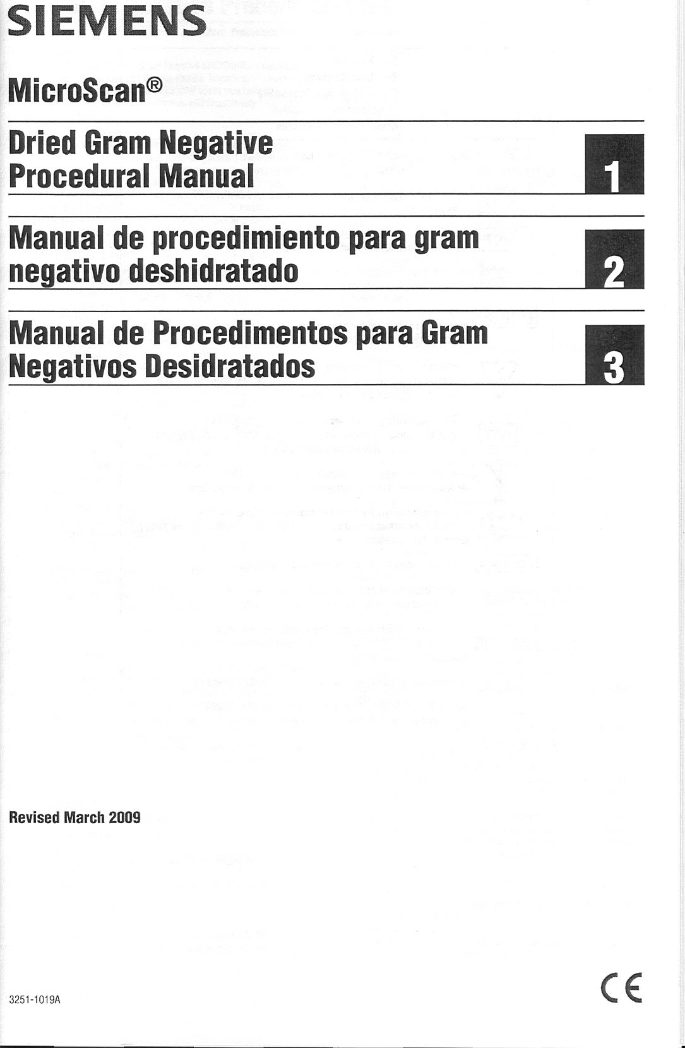

Slide 33
2012 M02-A11 and M07-A9
TECHNICAL UPDATES
Reading Plates and Interpreting Results
Staphylococcus spp. – Cefoxitin disk, read with reflected light
- Oxacillin disk, read with transmitted light
Vancomycin Resistance in S. aureus
Van. Agar Screen – many VISA with MIC of 4 µg/ml will not grow
S. pneumoniae Zone Diameter Interpretive Criteria
S. pneumoniae isolates with oxacillin zones ≤19 mm, must perform
penicillin MIC before reporting as resistant
Inducible Clindamycin Resistance
Clarified testing method to include disk placement distance for
Staphylococci
β–lactamase Tests
Mentions the Pen zone-edge test for β–lactamase testing of S. aureus

Slide 34
CLSI Antimicrobial Susceptibility Testing (AST) Recommendations
M02-A11, M07-A9, and M100-S22 Implementation Checklist
NA, not applicable
New CLSI Documents for AST
Have | Will Obtain | NA | Document
 |  |  | M100-S22. 2012. Performance standards for antibial susceptibility testing. Twenty-second informational supplement.
 |  |  | M02-A11. 2012. Performance standards for antibial disk susceptibility tests. Eleventh edition. Approved Standard.
 |  |  | M07-A9. 2012. Methods for dilution antibial susceptibility tests for bacteria that grow aerobically. Ninth edition. Approved Standard.
Other CLSI Documents for AST
 |  |  | M11-A7. 2007. Methods for antibial susceptibility testing of anaerobic bacteria. Seventh edition. Approved Standard.
 |  |  | M39-A3. 2009. Analysis and presentation of cumulative antibial susceptibility test data. Third edition. Approved Guideline.
 |  |  | M45-A2. 2010. Methods for antibial dilution and disk susceptibility testing of infrequently isolated or fastidious bacteria. Second edition. Approved Guideline.

Slide 35
Summary
M100-S22, M02-A-11, and M07-A9 All Updated for 2012
M100-S22, More Breakpoint Changes
M100-S22, Reporting of Isolates Resistant to All Antibiotics Tested
M100-S22, Pen zone-edge test for β-lactamase production by S. aureus

