Slide 1
APHL CLIA Training Projects
Karen Breckenridge, MBA, MT(ASCP)
CLIAC Meeting
March 5, 2014

Slide 2
Project Background
RFP first released in fall of 2011
Funded through CDC/APHL Cooperative Agreement
Modeled after the APHL Innovations in Quality Public Health Practice program
Awards were up to $15,000 each
Proposals accepted from APHL member laboratory staff
Partnering with other entities was encouraged
Quarterly milestones to be reported
Training materials developed to be shared with others
http://www.aphl.org/mrc
All training components must have an evaluation
Final report must contain evaluation results
Selection team from APHL, CDC and PHLs

Slide 3
Training Topics
Proposed training projects should be targeted for clinical or physician office laboratories and address one or more of the topics below:
Developing and delivering waived testing training for POLs
Developing and delivering training on a CLIA related topic such as proficiency testing, competency training, validation studies, etc.
Delivering training using tools already available, such as CDC’s “Ready? Set? Test?” materials or APHL’s Bench aids
Developing tools for preparing for a CLIA inspection
Developing and delivering training for quality management systems (QMS)

Slide 4
Proposals
Round 1 for project completion June 2012
16 applications, 13 accepted, 2 withdrawn, 1 requested extension
Round 2 for project completion June 2013
8 applications, 8 accepted, 1 on hold
Round 3 for project completion June 2014
4 applications, 4 accepted, 1 on hold
Total of 21 awards, 3 in progress

Slide 5
Award Recipients
AK - 1 | ID - 1 | NJ - 1 | MT - 2
AL - 1* | HI - 2 | NM - 1 | PA - 1
FL - 1* | KY - 1 | MI - 1 | WI - 3
IA - 2 | NH - 2* | MN - 1 | WV - 2
City of Milwaukee - 1 |  |  | *application withdrawn after acceptance

Slide 6
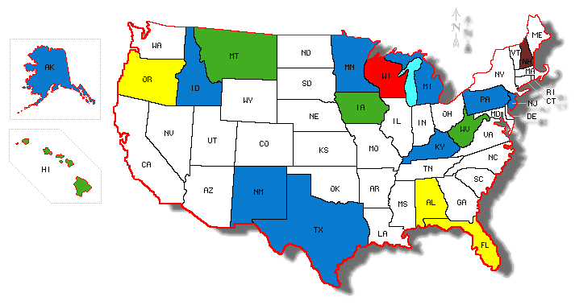
CLIA Training Awards
Received 1 CLIA Training Award
Received 2 CLIA Training Awards
Received 3 CLIA Training Awards
Received 2 CLIA Awards and withdrew 1 Award
Withdrew 1 CLIA Training Award
Notes:
http://diymaps.net/userimages/564584.gif

Slide 7
Target Audiences
Over 2650 participants
Types of students
POL staff
Certificate of Waiver Laboratory staff
Hospital Laboratory staff
Public Health Laboratory staff
Public Health Nurses
Clinical laboratory scientist students

Slide 8
Training Modalities
Seminar (less than ½ day)
Workshop (all day)
Online courses
CD or DVD

Slide 9
CLIA Training Topics
CLIA Overview
Waived testing for POLs
Good Laboratory Practice
How to Read a Package Insert
Urine Dip Stick Testing
Hemacue Test
Laboratory Safety
Preparing for a CLIA Inspection
Top 10 Deficiencies
Competency testing
Proficiency Testing
Wet Mounts

Slide 10
QMS Topics
Quality Management for AST
Streamlined QC
Verification and QC of a new drug panel
Using CLSI Guidelines for Training and Competency Assessment
Management of Non-conforming Laboratory Events and Development and Use of Quality Indicators
Providing Quality Laboratory Services

Slide 11
Supplemental Materials
CDC’s “Ready, Set, Test!”
MMWR (2005) “Good Laboratory Practice”
APHL’s Bench Aids
CLSI Documents
APHL Webinar

Slide 12
Training Partners
CMS regional offices
State CLIA surveyors
Public health agencies
Hospital laboratories
Universities

Slide 13
Measuring Impact
Pre and post test scores
Participant evaluations
Surveyor feedback

Slide 14
Pre and Post Test Examples
Certificate of waiver
Average pre test = 81.5%
Average post test = 93.8%
QMS
Average pre test = 48%
Average post test = 81%

Slide 15
Participant Evaluations
Feedback was extremely positive at all sites and for all modalities
Many requests for additional training
Many promises for changes to current practices

Slide 16
Changes to Practices
Will use a timer for urine dip sticks
Will run controls and write down the results
Will write “positive” instead of a check mark
Will buy a timer and use it
Will check staff for color blindness
Will read package inserts
Will take ambient air temp

Slide 17
Sample Participant Comments
Good laboratory practice goes beyond meeting requirements.
Proper testing procedure is very useful to getting proper results.
The glucometer is not a diagnostic tool, use for monitoring only.
I must make sure I perform the correct test for the testing device.

Slide 18
Surveyor Feedback
“State Surveyors have noticed during COW inspections that participants were very satisfied with the training and pointed out changes to the surveyors that they had made to their laboratory practices as a result of the training.”

Slide 19
Surveyor Feedback
24 certificate of waiver surveys conducted
16 had attended training
Received congratulations or recommendation letters
8 had not attended training
Received requirement or enforcement letters
Surveyor stated:
“The better outcome on the knowledge of good laboratory practices demonstrates that the project did have a positive impact on laboratories viewing the product.”

Slide 20
Pay it Forward
APHL sponsored workshop for 25 using materials developed by MT
NJ used materials developed by AK for their 6 workshops
WV used material from round 1 to train more
ID created extra materials for attendees to take to train others
iD

Slide 21
Round 4 Proposals
RFP released May 2014
Funding for 4-6 awards
Must partner with a PHL
All projects complete by June 15, 2015

Slide 22
For More Information
www.aphl.org/mrc
use CLIA as the search word
karen.breckenridge@aphl.org
eva.perlman@aphl.org

Slide 23
Thank you to CDC
Laboratory Practice Standards Branch
Division of Laboratory Programs, Standards, and Services
Center for Surveillance, Epidemiology, and Laboratory Services
Office of Public Health Scientific Services

