Slide 1
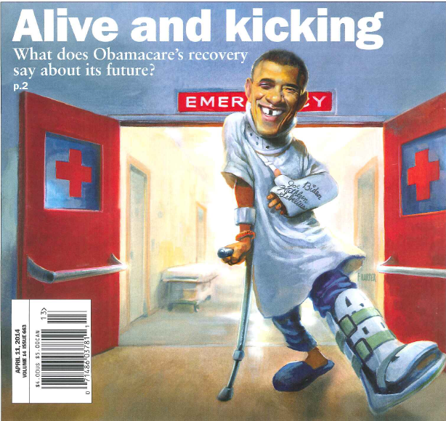
Healthcare Transformation: Who Will Be Alive & Kicking?
Patrick F. Luedtke MD, MPH
Senior Public Health Officer
Medical Director, Community &
Behavioral Health clinics
Dept. of Health & Human Svcs.
June 4, 2014

Slide 2
U.S. Health Spending: The Perfect Storm
Rising health care costs
Demographic changes
Mounting fiscal and budgetary pressures
Source: Lydia Ogden, Centers for Disease Control & Prevention

Slide 3
Data Source: Centers for Medicare & Medicaid Services, Office of the Actuary
NOTE: United States Nominal Gross Domestic Product in 2010 = $14.7 trillion

Slide 4
Source: Todd SR, Sommers BD, ASPE/HHS. Overview of the uninsured in the United States: A summary of the 2012 Current Population Survey Report. September 12, 2012. http://aspe.hhs.gov/health/reports/2012/UninsuredInTheUS/ib.pdf

Slide 5
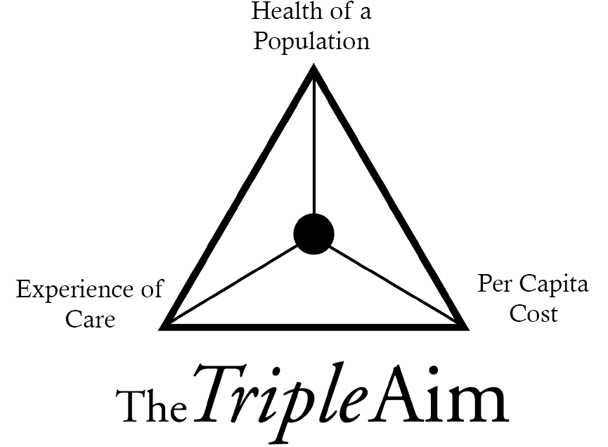
Health Reform & The Triple Aim
Better care for individuals
Better health for populations
Lower cost growth thru improvements in care
Donald M. Berwick : N Engl J Med 2011; 365:1753-1756

Slide 6
Transforming Healthcare: Questions for PHLs:
Is my State expanding Medicaid? If so, how? If not, what transformation is happening?
What healthcare quality improvement initiatives are occurring (and funded!) in my State?
What opportunities are available to PH and PHLs? (e.g., Prevention & Public Health fund, ACOs/CCOs)

Slide 7
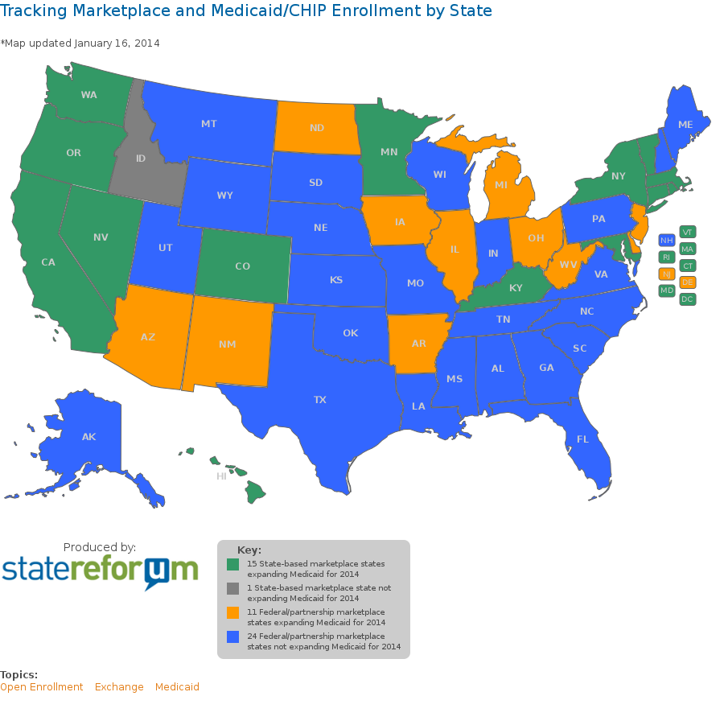

Slide 8
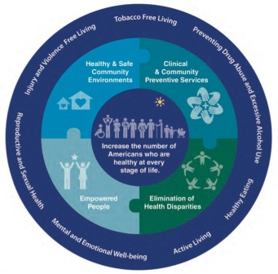
The Affordable Care Act & Quality Improvement
New Center for Medicare and Medicaid Innovation (CMMI)
Testing new models:
Accountable Care Organizations (ACOs)
Patient-centered medical homes
Bundled payments
National Strategy for Quality
Partnership for Patients – prevent healthcare associated harms; support better care transitions

Slide 9
The Affordable Care Act: Prevention and Public Health
Requires new plans and Medicaid “expansion” plans to cover proved clinical preventive services without cost sharing; encourages traditional Medicaid to do so; and requires that to the extent Medicare covers such services, it does so without cost-sharing
Authorizes the first-ever National Prevention Strategy
Appropriates funding for the Prevention and Public Health Fund
Rebuilds the Primary Care Workforce: Expands National Health Service Corps for providers in underserved areas; incentives to expand the number of primary care MDs, nurse practitioners, and PAs; scholarships and loan repayments for those working underserved areas

Slide 10
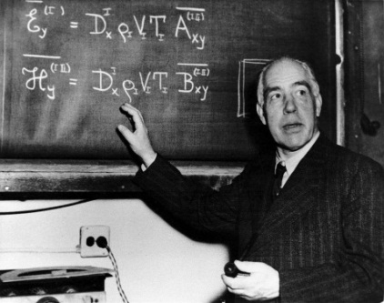
“Prediction is very difficult, especially if it’s about the future.”
-Niels Bohr

Slide 11
Overview of Heath System Transformation
Health Delivery System Transformation Critical Path
Community Integrated Healthcare System 3.0
Coordinated Seamless Healthcare System 2.0
Community Integrated Healthcare
Outcome Accountable
Care
Acute Care System 1.0
Episodic Non-Integrated Care
Healthy population centered
Population health focused strategies
Integrated networks linked to community resources capable of addressing psycho social/ economic needs
Population-based reimbursement
Learning organization capable of rapid deployment of best practices
Community health integrated
E-health and telehealth capable
Patient/person centered
Transparent cost and quality performance
Accountable provider networks designed around the patient
Shared financial risk
HIT integrated
Focus on care management and preventive care
Episodic health care
Lack integrated care networks
Lack quality and cost performance transparency
Poorly coordinate chronic care management
Source: Neal Halfon, UCLA Center for Healthier Children, Families & Communities

Slide 12
A Tale of Two Public Health Jurisdictions
Health Dept. A
Population 1.2 million
State is expanding Medicaid
Medicaid: Incentivized cost and quality metrics with population health goals (e.g., maternal tobacco use, obesity, diabetes)
Medicare: Incentivized quality & performance metrics centered on chronic dz (e.g., Medicare Stars)
PHL opportunities with new population health projects
Migration of select LHD & PHL clinical work to new Medicaid entities (e.g., STDs, TB, VPDs)
Health Dept. B
Population 1.1 million
State is not expanding Medicaid
Quality & cost initiatives coming via Medicare programs (e.g., Medicare Stars program)
Other incentivized population health goals (CMS model grants)
Likely continuation of LHD direct patient care work in the near term (e.g., STD, TB, VPDs)
Growing fiscal pressures will foster creative solutions (e.g., CMS Innovation Center, SIMs, CTGs, HCIAs)
vs.

Slide 13
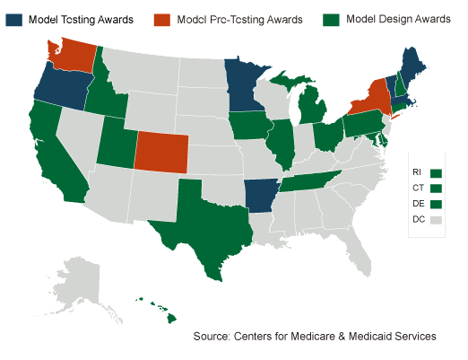

Slide 14
Looking for Opportunities
Think “solving problems, creating value”
Understand the basics of health policy & insurance
Study the innovators
Akron, Ohio
Minnesota
Hennepin Health: Hennepin County
SIMs testing award
ReThink Health communities
Atlanta: ARCHI
Upper Connecticut River Valley
Pueblo, Colorado

Slide 15
Looking for Opportunities
Get an MBA-type of understanding of your lab’s & department’s current business(es):
service mix
revenues
costs
“profit and loss”
accounting and IT
Study the surrounding insurers and providers
Capacities, competition, motivations
new models of care (ACOs, 1115, community benefit obligations)
new grants and awards (SIM, CTG, HCIA, etc.)

Slide 16
Looking for Opportunities
Forge new relationships
Get to the table with value-added ideas
Defend inherently governmental services
Increase their visibility
Market their value

Slide 17
http://metacat2.com/GHPCPhaseII/ghpcplanningtool_interactive.pdf

Slide 18
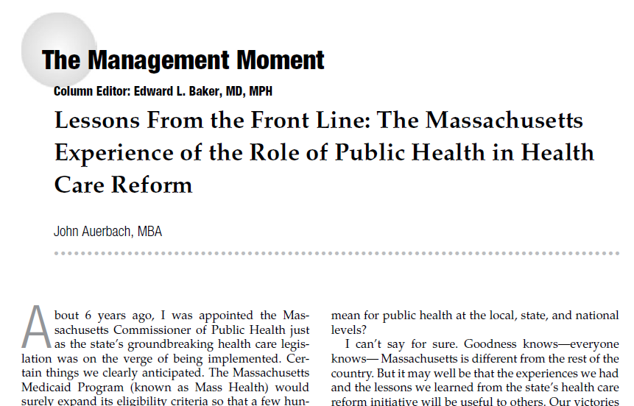
Source: J Public Health Management Practice, 2013, 19(5), 488-91

Slide 19
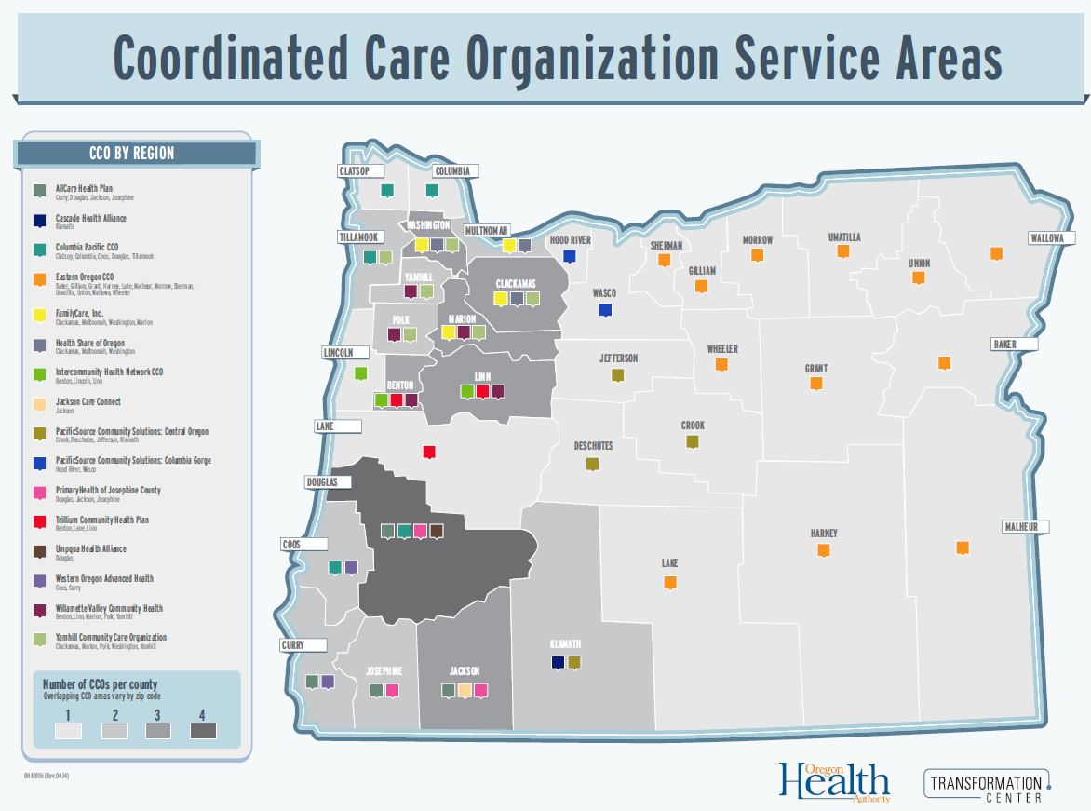

Slide 20
Transition to Dr. Skeels

Slide 21
How the New World Order Works
Vital statistics birth data review.
Federally qualified health centers pregnant patient chart review.
Public Health (PH)
“We have too many preemies and pre-term labor cases.”
Obstetrics/Gynecology (OB/GYN)
Claims data review for preemie/pre-term labor costs. (CCO)
PH-PCP-OB/GYN steering committee
“All my pregnant patients smoke!”
Primary Care Physicians (PCP)
Nicotine testing & incentive $$ for pregnant smokers

Slide 22
Smoking in Pregnancy
Data Source: Oregon Health Authority

Slide 23
Lane County: Smoking in Pregnancy
Age | Smoking Rate | Patient Number
<20 | 27% | 294
20–24 | 25% | 860
25–29 | 16% | 1,147
30–34 | 11% | 843
35–39 | 9% | 348
>/= 40 | 11% | 81
NOTE: Survey of current use rates: FQHC, PeaceHealth hospitals/clinics, Douglas county.
Data Source: Lane County Vital Statistics: 2009

Slide 24
Clinical Expectations
Prenatal smoking is associated with:
30% of small for gestational age (SGA) infants
10% of preterm infants
5% of infant deaths*
Expected quit rate, without incentives is ~37%**
Decreased ear infections and asthma attacks in child
*MMWR 58(ss04);1-29 May 26, 2009 ** PRAMS 2005

Slide 25
Medicaid Savings
Preventing 1 SGA birth = $45,000 savings
$1 spent on cessation = $3.50 in neonatal savings
Data Source: CDC, Smoking-Attributable Mortality, Morbidity, and Economic Costs (SAMMEC)

Slide 26
Fiscal Data
Lane County Medicaid Neonatology Costs (2012)
Line item cost | $7,643,967
# of Episodes | 1,773
Cost/Episode | $4,311
Unique members | 1,715
Monetary goal: 10% cost reduction/yr (ROI = 7.6)

Slide 27
Tobacco Cessation Incentive Program
Program started August 2013
3,500 births/year in Lane County, 50% Medicaid (600 use tobacco)
PHL Testing:
3x during pregnancy
1x at six weeks post pregnancy
Total possible incentive = $200 (Budget: $100,000/yr)

Slide 28
Many Thanks to…
CDC staff & programs:
a.) Fred Shaw MD, JD
b.) Judy Monroe MD
c.) Division of Reproductive Health
d.) Office on Smoking and Health
e.) Pregnancy Risk Assessment Monitoring
System
Jennifer Webster MPH (Lane Co. Public Health)
Holly Jo Hodges MD (Trillium CHP)

