Slide 1
Public Health Laboratories
[Name]
[Title]
[Email]
Notes:
[Use your laboratory logo or template for this and all the other slides]

Slide 2
Public Health Practice is
the science and art of disease prevention, prolonging life and promoting health and well-being through organized community effort.
Notes:
When I was in your place, I had a poor understanding of the difference between the science I was learning through academia and what actually happens in a health department.
So I thought I’d start with a definition of public health practice. . .
[read]
This is what public health labs do every day.
The key difference between academic labs and PH labs is the connection to the community.

Slide 3
Overview
Public Health Laboratories (PHLs)
Environmental Laboratories
PHLs in Action
Association of Public Health Laboratories
History
Notes:
Here is what I hope to cover today.
Please stop me as often as you want.
I’d rather make this a discussion and not a lecture.

Slide 4
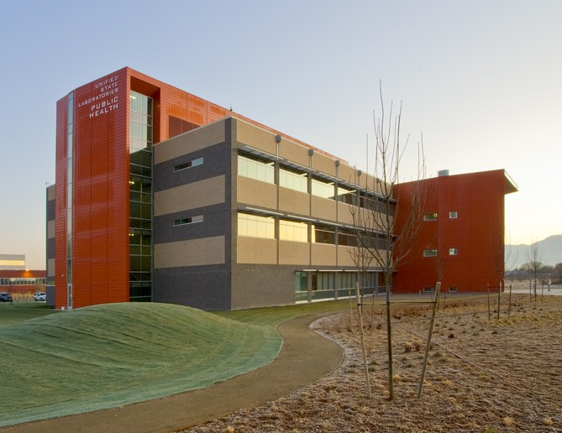
Public Health Laboratories
Notes:
Public health laboratories are state & local labs integrated into the broader public health system.
They perform complex testing to protect communities from disease and other health threats.
They serve as an early warning system for things like flu outbreaks and food-borne illness.
Such testing requires highly-trained staff, sophisticated instrumentation and specially-designed facilities.
[Photo: new Utah public health laboratory, 2010 . . .feel free to insert your own lab]

Slide 5
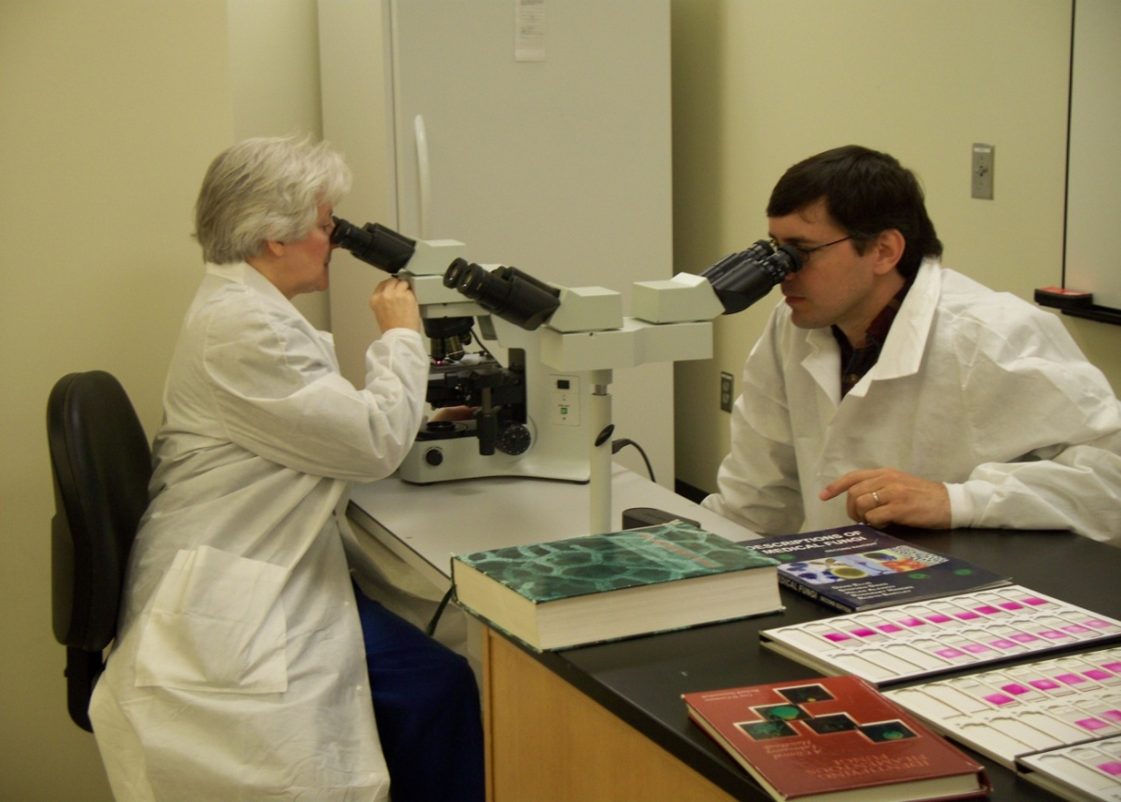
Disease Detectives
Notes:
PHL scientists have been called disease detectives.
Some examples of our work include:
Identifying emerging diseases like the novel H1N1 flu virus and SARS.
Detecting disease outbreaks involving things like flu, E. coli, and drug-resistant tuberculosis
Screening virtually all babies born in the US for potentially life-threatening disorders
Testing drinking water for harmful bacteria, parasites and chemicals
Measuring the amount of environmental contaminants—like pesticides, mercury or lead—that gets into people.
Unlike medical laboratories that run tests for individual patients, PHLs safeguard entire communities.
Photo: PHL scientists learning highly specialized techniques for identifying fungi—a service not commonly performed by private labs.

Slide 6
Informing Decisions & Policy
Notes:
Despite being invisible, the work these labs perform is critically important to everyday people, businesses, and the overall economy.
Health officials, emergency responders, policy makers and law enforcement officials all rely on PHL data.
The scientist at left is preparing to test a sample of tomatoes for Salmonella at the New Mexico state public health laboratory during a 2008 outbreak.
Without such testing it would be difficult to determine whether a sudden increase in illness is related to a specific food, and whether a recall is necessary.

Slide 7
“Unlike private institutions, the Hinton State Laboratory Institute has the mission and authority to focus on public problems. .. It addresses small problems before they become big and big problems before they become catastrophes.”
Tom Garvey, MD Primary Care Physician
Notes:
In a comment on an editorial in a Boston paper, a physician noted that “unlike private institutions, the Hinton State Laboratory Institute has the mission and authority to focus on public problems.”
As he said, it “addresses small problems before they become big, and big problems before they become catastrophes.”
His distinction between private and public labs is important:
Private labs focus on individual health, for example routine diagnostic testing (i.e. cholesterol) & medical management (if you’re on blood thinners).
PHLs focus on:
Non-routine Diagnostic Testing (such as rabies)
Reference Testing
Surveillance & Monitoring
Oversight of Quality Laboratory Testing

Slide 8
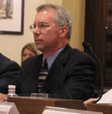
Peter Shult, PhD Wisconsin State Laboratory of Hygiene
“The state PHL is the only lab with the culture & the mentality of emergency response.
We’re [the only] emergency responders from the lab perspective.”
Notes:
Another example of its uniqueness is captured in this quote, [read slide]
It doesn’t make sense for private laboratories to maintain the ability to do tests that are not routine & which are not going to generate a profit.
That most important thing that sets public labs aside from private ones is the mission of serving the public.

Slide 9
Core Capabilities of a PHL
Disease Prevention, Control & Surveillance
Newborn Screening & Genetics
Reference & Specialized Testing
Environmental Health & Protection
Food Safety
Emergency Preparedness
Integrated Data Management
Lab Improvement & Regulation
Policy Development
Research
Training & Education
Partnerships & Communication
Notes:
You might be surprised at all that we do! Core capabilities of PHLs as defined by our national membership association, APHL, include

Slide 10
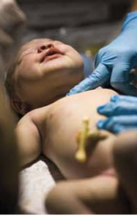
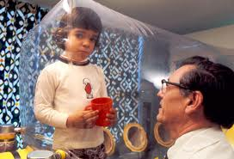
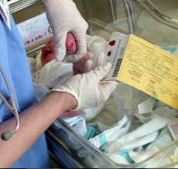
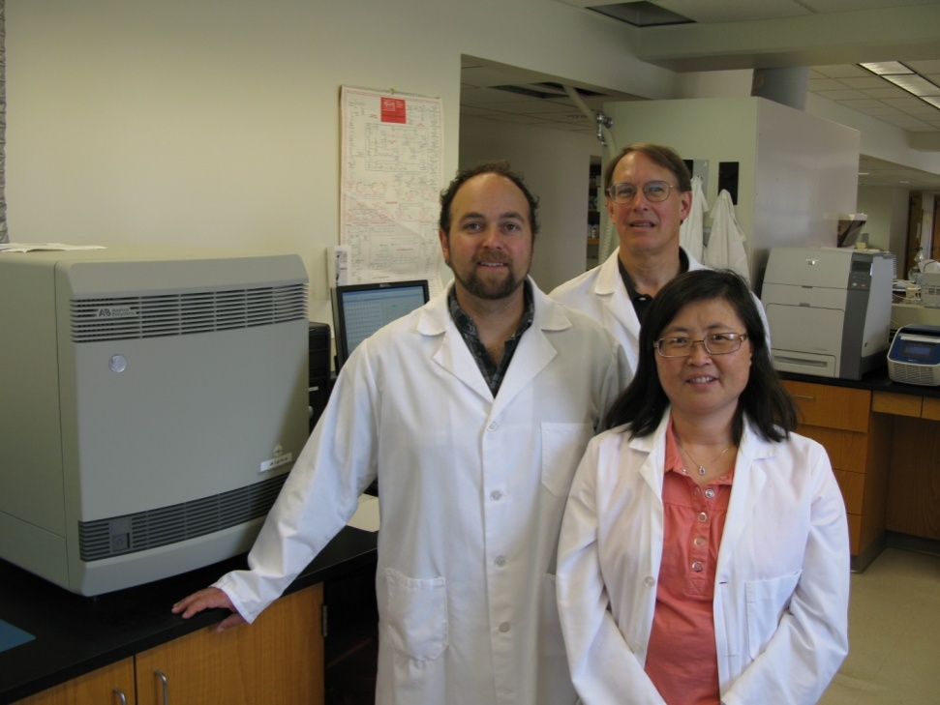
Notes:
Collectively, PHLs perform (or oversee) the screening of 97% of the babies born in the US each year,
testing for more than two dozen conditions that can result in death or disability if not treated soon after birth;
conditions like cystic fibrosis, hypothyroidism, sickle cell disorders and PKU.
Of the 4.5M US babies screened annually, over 5,000 screen positive for a genetic or inherited disorder.
PHL screening data enables these babies to receive immediate follow-up testing and early diagnosis and treatment.
PHLs also help to develop new tests and help authorities determine which new tests should be added to the screening panel.
I want to point out the top right photo, pictured is David Vetter in isolation, due to a condition commonly called Bubble Boy Disease.

Slide 11
“if SCID is identified in the first months of life, such as through newborn screening, and before severe infections occur, most infants are successfully treated.”
Jennifer Garcia TX mom
Notes:
Pictured here are Gavin Garcia, who is 5, and his little brother Cameron, who is forever 9 months old, as his mother describes him.
Cameron passed away from complications of what is sometimes called Bubble Boy Disease, but scientifically known as Severe Combined Immunodeficiency or SCID.
Before 2008, no laboratory in the world routinely screened newborns for SCID.
But that year, the Wisconsin state PHL developed screening assay and began a pilot program.
Since then they have screened more than 200,000 infants and
helped identify at least 5 babies who required a bone marrow transplant, plus
several others with severe immunodeficiencies requiring medical attention.
In 2010 the US Secretary of Health and Human Service's added SCID to the panel of disorders recommended by the federal government for newborn screening;
now 3 additional states are conducting pilots for SCID testing.

Slide 12
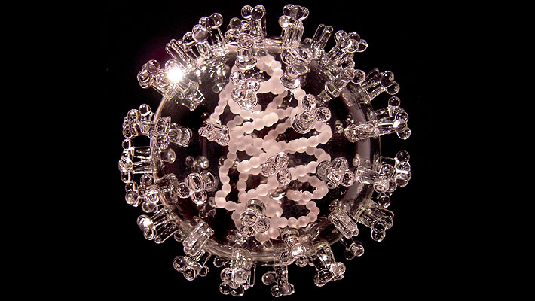
Infectious Diseases
Notes:
PHLs are the nation’s first line of defense against infectious diseases.
When novel strains of influenza arise—like 2009’s H1N1—PHLs are the first to implement new tests to definitively confirm the infection in patients.
For many weeks after H1N1 was first identified in the US, the CDC influenza laboratory and PHLs were the only labs capable of confirming infection.
At the height of the crisis, officials had to make decisions about school closures, vaccinations, the best use of limited supplies of antiviral agents and general advice to the worried well.
Those decisions needed to be based on sound scientific data, including the prevalence of laboratory-confirmed infection.
Knowing which schools, hospitals and communities had the greatest burden of infection helped authorities respond effectively.
Photo: glass sculpture of 2009 H1N1 virus by Luke Jerram. See http://www.lukejerram.com/.

Slide 13
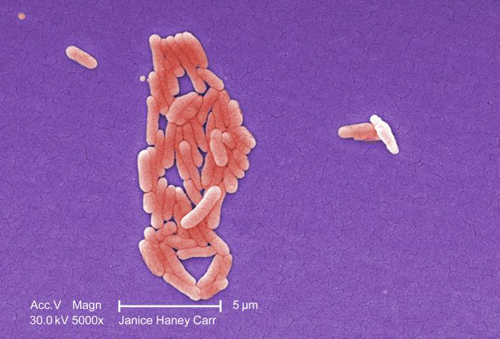
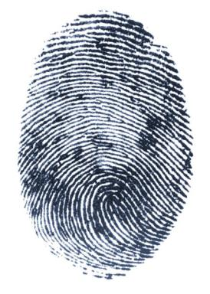
Food Safety
Are the new cases of food poisoning random
… or the beginning of an outbreak?
Notes:
The industrialization & globalization of the food supply have made large-scale food-borne disease outbreaks more common.
In the past few years alone, we’ve seen outbreaks associated with
E coli in spinach (2006),
E. coli O157:H7 in beef (2009-2010),
Salmonella Enteritidis in eggs,
salmonella in peanut butter in 2009, and
just this year listeria in cantaloupes.
PHLs work to help identify foodborne outbreaks—and their source—as quickly as possible so contaminated foods can be recalled & fewer people become sick.
Because random cases of food poisoning occur routinely, there is a lot of background noise that can complicate disease investigations.
PHLs determine which cases of food poisoning are related—and therefore part of an outbreak—and which are not.
PHLs are part of an international network that generate DNA “fingerprints” of food-borne bacteria cultured from people who got ill.
A central database enables related cases to be linked, even if the infected patients are in different parts of the country (or world).

Slide 14
Notes:
[Feel free to insert your own stories throughout the presentation. Students really love hearing about day-to-day activities and challenges. Please also share your slide with APHL, so we can showcase your great work too!]
On December 21, 2008, state health workers in MN spotted a cluster of cases of food-borne illness: three nursing home residents ill with Salmonella.
The cluster coincided with other similar reports – both in and around the state.
Luckily, MN is one of 30 states that require all other labs to send specimens containing high-priority infectious pathogens to the state PHL.
Once they received the specimens, MN’s PHL ‘fingerprinted’ the bacteria within 2 days.
They found that all the patients were infected with the same strain of Salmonella—clear evidence that there was a common food source.
Photo: Minnesota Public Health Laboratory

Slide 15
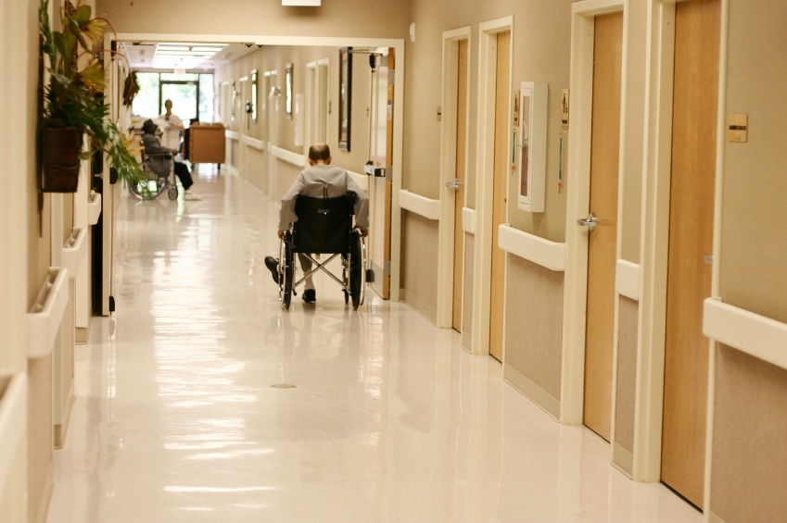
Notes:
MN’s ‘Team Diarrhea,’ interviewed each patient about what foods they had eaten, raising suspicions about either peanut butter or a chicken product.
Within 7 days, the DOH determined that many patients ate meals in one of three institutions: two long–term care facilities and an elementary school.
Looking at their menus & grocery receipts revealed a common food distributor, based in North Dakota.
Just one food item was ordered by all three institutions: King Nut creamy peanut butter.
Within three weeks of spotting the cluster, the Minnesota agricultural laboratory isolated Salmonella from a container of King Nut peanut butter.
Health officials immediately issued a product warning, and Peanut Corporation of America’s Blakely, GA plant was promptly shut down.
Overall, the outbreak sickened over 700 people nationwide, 100 people were hospitalized and 8 died.
It also prompted one of the most extensive food recalls in US history—affecting more than 3,000 products.
The swift work of the MN PHL hastened the end of the outbreak and undoubtedly saved many more people.

Slide 16
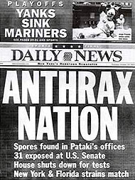
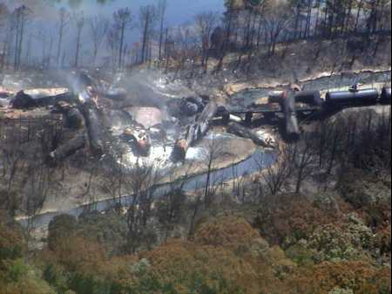
Notes:
Public health laboratories respond to virtually any health threat, whether it’s an infectious disease outbreak, industrial accidents, toxic chemical spill, natural disaster or a suspected terrorist event.
Pictured are a copy of a newspaper from the 2001 anthrax attacks, a train derailment leaking hazardous chemicals, and a ship spraying oil dispersants.
Nikki Lurie from the US Department of Health & Human Services recently said “If you can’t detect it, you can’t respond to it”.

Slide 17
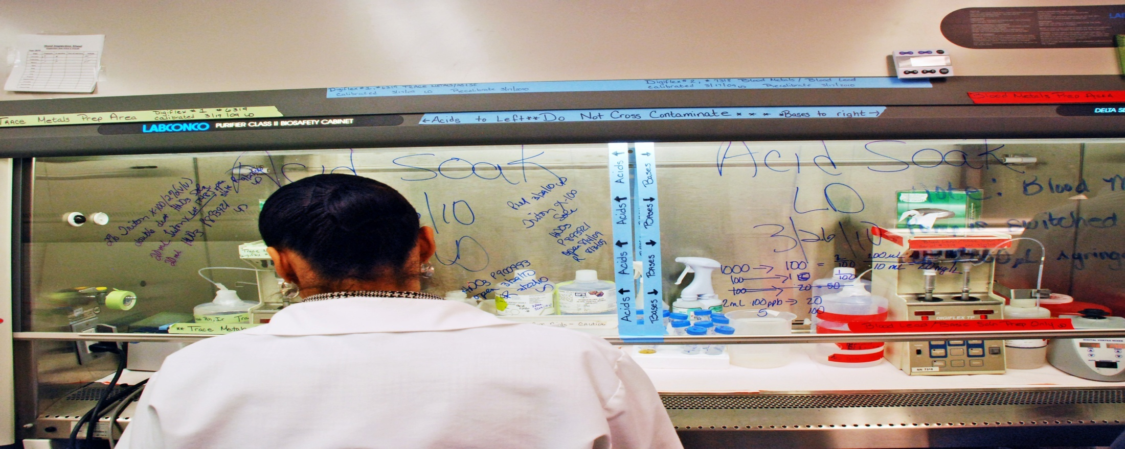
Notes:
This photo shows a Utah PHL scientist analyzing a sample of unknown toxic chemicals that leaked from a tanker car sitting in a train yard in South Salt Lake City in 2005.
The ‘toxic soup’ was determined to contain seven agents, including hydrofluoric acid, which is so caustic it is classified as a potential agent of chemical terrorism.
PHL testing was critical to determine human health risks, necessary abatement measures (including excavation of contaminated dirt) and when residents and business owners could safely return to the area.

Slide 18
Notes:
So the bottom line is that PHLs protect us by distinguishing between apparent and real health threats.
We are able to definitively confirm the presence of a threat, or to sound the “all clear” if it’s not present
We:
-quickly analyze threats to our health
-seek to answer question of “what is it?”
-act by alerting health officials or law enforcement

Slide 19
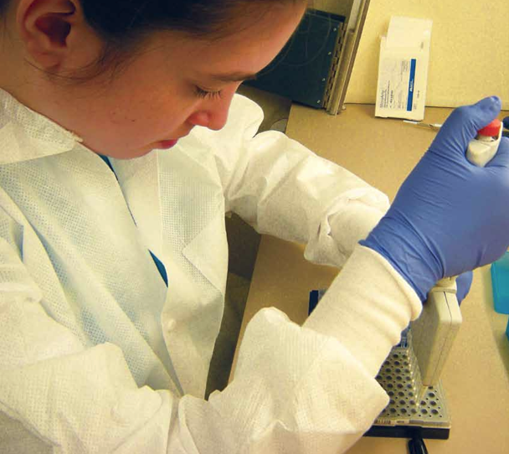
Providing Data to Inform Public Policy
Notes:
Let me come full circle to emphasize a key message: PHLs provide scientific data to inform public policy, including:
** Infectious disease response activities, such as school closures and appropriate distribution of vaccines or medication
** Food recalls
** Imposition and lifting of boil water orders when water safety is questioned
** Fish consumption advisories
And many, many others.
Photo: Laboratory scientists pipetting.

Slide 20
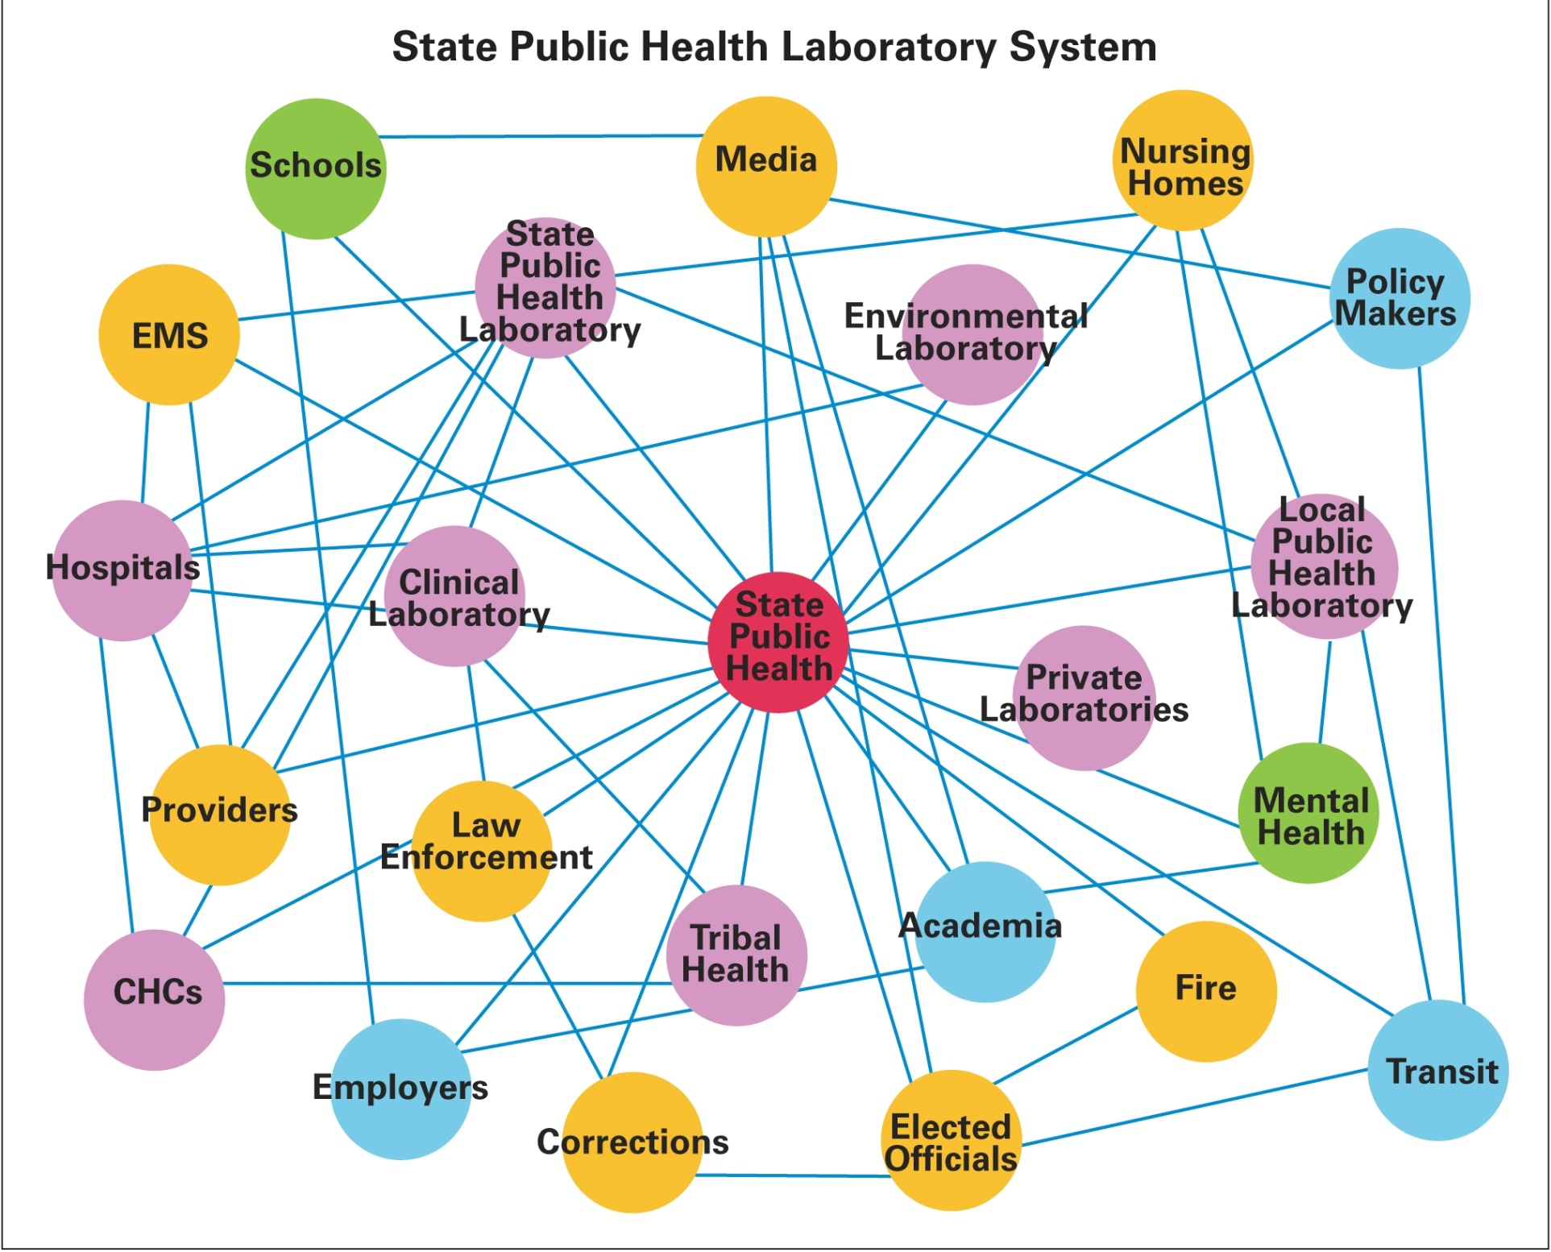
Notes:
The system in which these labs work is huge and complex.

Slide 21
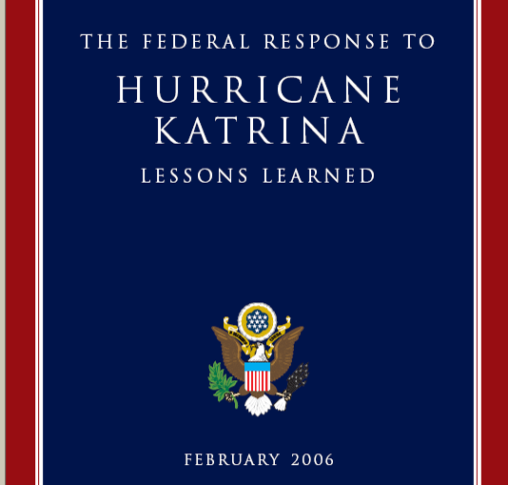
Notes:
That well-networked system led to recognition from President Bush following Katrina.
In the section of the White House Lessons Learned document that was titled: “WHAT WENT RIGHT!”, the report talks about
The fact that multiple PHLs volunteered to assist the devastated LA & MS state PHLs.
That FL sent a mobile drinking water lab & personnel to MS, helping to prevent people from getting sick from contaminated water.
IA performed 12,000 newborn screening tests
It doesn’t mention that TX & AR provided drinking water testing for LA.

Slide 22
Notes:
[Again feel free to create your own slide here]
Let’s take the Maryland State Public Health Lab as an example of how PHLs have changed over time.
It was established in 1898 to respond to typhoid fever, malaria, diphtheria, food-borne illness, tuberculosis, and drug testing, among others.
Over 100 year later it performs. 11M tests each year.
Today it focuses on virus isolation and identification, emergency preparedness & response, white powder testing, WNV, measuring chemicals in people such as lead, HIV drug resistance, newborn screening, and still food-borne illnesses.

Slide 23
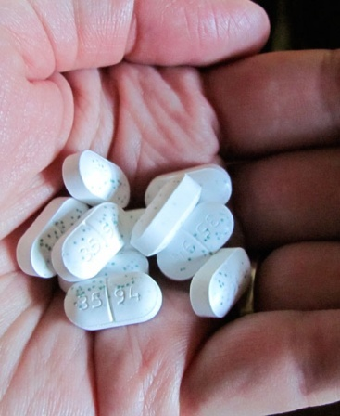
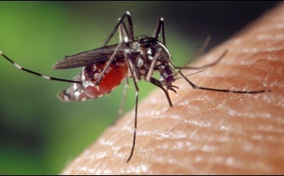
And the Future?
Notes:
The point is nothing stays the same. Certainly not disease threats. And certainly not technology.
Here are just a few of the changes we’re planning for:
New or changing infectious disesases
Due to changing climates, evolving land use patterns and global movement of both people & goods, new diseases find their way to the US faster than ever.
Dengue fever, a mosquito-borne virus typically found in the jungle, and which can cause severe illness or death, has already been reported in FL.
XDR-TB and Clostridium difficille (which now rivals MRSA as a hospital-acquired infection) all recently acquired resistance to even our best antibiotics .
- A form of avian influenza that is easily transmitted from person-to-person was recently created in a lab: a huge concern given that the mortality rate would be about 50-60%.
New technology:
Nano-scale means that we can make better and better use of small samples.
Multiplexing—testing for multiple disease organisms in one assay—is already possible and will get even better.
So will molecular testing to look for genetic changes.
New(ly) recognized pollutants:
- pharmaceutical agents, which enter groundwater or even drinking water supplies from discarded medications (often flushed down toilets), our own urine & feces, and through the manure of farm animals.

Slide 24
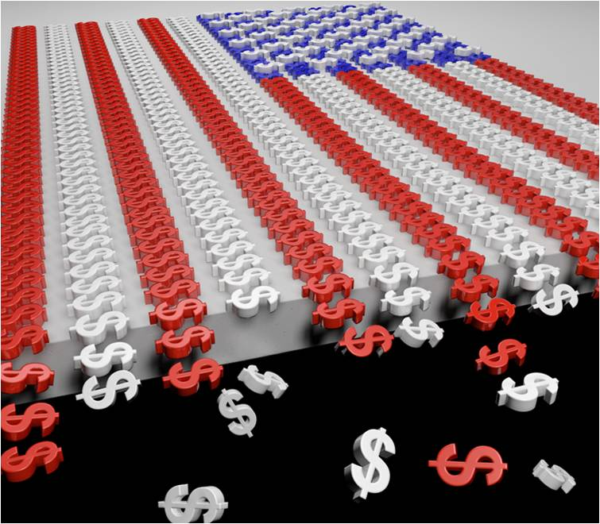
Dwindling Funding
Notes:
It always comes back to money, doesn’t it?
State PHLs receive much of their funding from the federal & state government.
Because it is very time-consuming and labor-intensive to get testing programs up and running (and then to maintain and upgrade expensive testing equipment), it is extremely important that PHLs be able to rely on consistent, long-term funding.
Historically, PHLs have been under-funded.

Slide 25
Overview
Public Health Laboratories (PHLs)
Environmental Laboratories
PHLs in Action
Association of Public Health Laboratories
History
Notes:
Before I move on, any questions?
In some States the PHL houses the environmental laboratory, in others they are located in a different agency than the PHL. . .
Before we get into the specifics of what environmental health work happens in governmental labs. . .

Slide 26
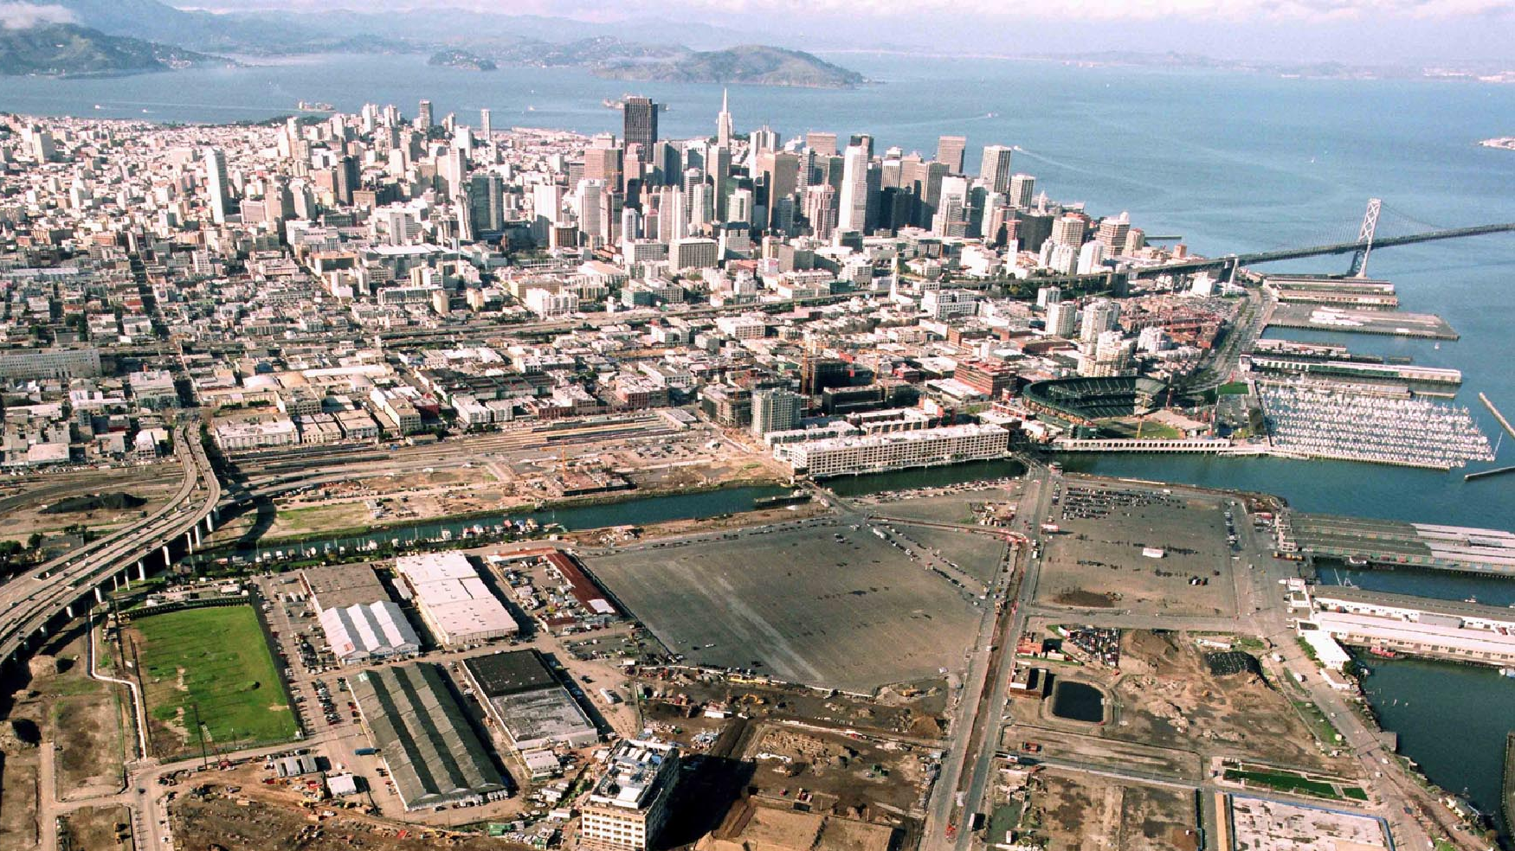
Environmental Health (EH)
Notes:
Let’s talk about field of environmental health in general.
Is anyone brave enough to try to define it?
APHL operates under the assumption that:
Everything around us affects our health and well-being:
from the air we breathe,
the water we use, and the food we eat,
to the buildings and the neighborhoods in which we live.
Can anyone name the leading causes of illness and death in the US?

Slide 27
*CDC 2007 data, http://www.cdc.gov/nchs/fastats/deaths.htm
Notes:
Data from CDC shows leading causes of death in 2007...
They’re non-infectious diseases such as heart disease, cancer, diabetes etc.
Genetics has only been able to explain a small percentage of what causes the most common chronic diseases, while lifestyle only explains some of it.
Some scientists estimate environmental factors account for up to 90% of the chronic diseases.
If scientists are able to analyze and understand environmental exposures and how they play a role in chronic diseases, this will translate into enormous savings in health care expenses and lost wages.

Slide 28
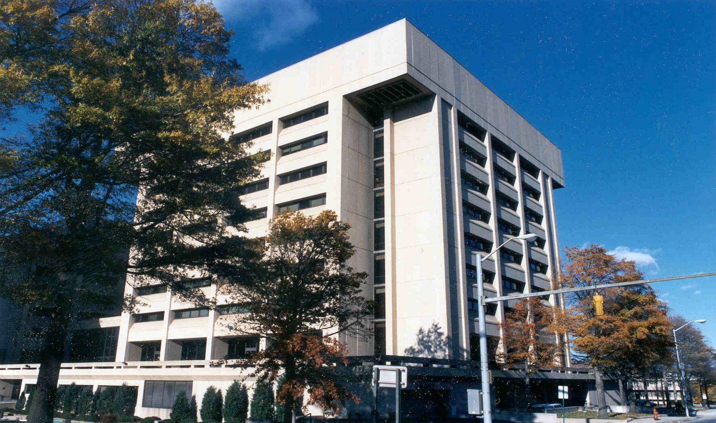
Environmental Laboratories
Detect, identify, & monitor contaminants
in people and the environment.
Notes:
[again feel free to change the photo]
Let’s get back on track and talk about environmental labs. . .
Generally, [read slide]
the next few slides break this work down visually. ..

Slide 29
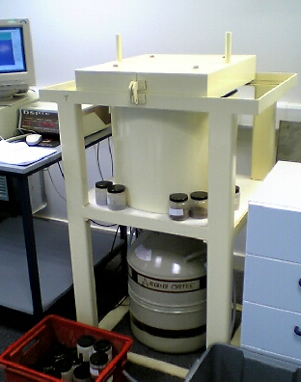
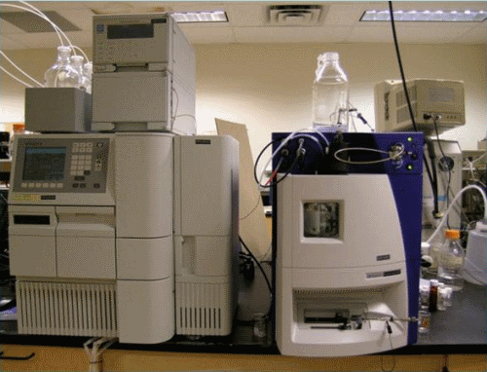
Detect, identify & monitor. . .
Notes:
ELs [read]
Pictured are some of the equipment used to “detect, identify & monitor” environmental contaminants:
Does anyone know what they are?
I won’t bore you with technical terms, but I will tell you they are complex instruments and that yes they are expensive (both to purchase & maintain).
[a liquid chromatograph, a gamma spectrometer, and a trusty microscope]

Slide 30
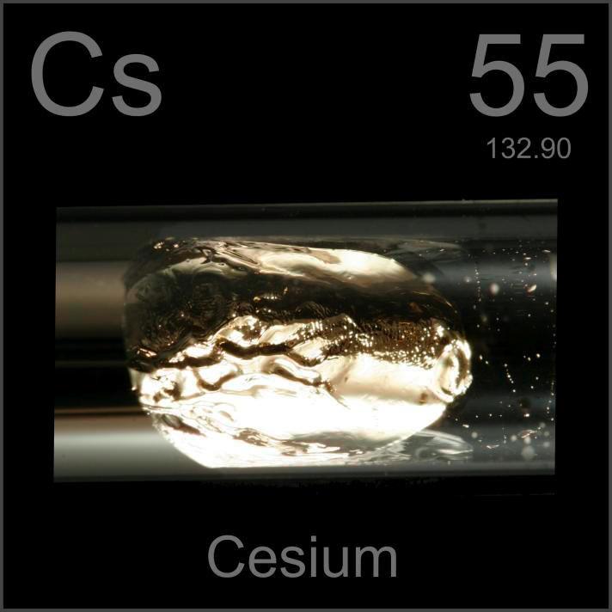
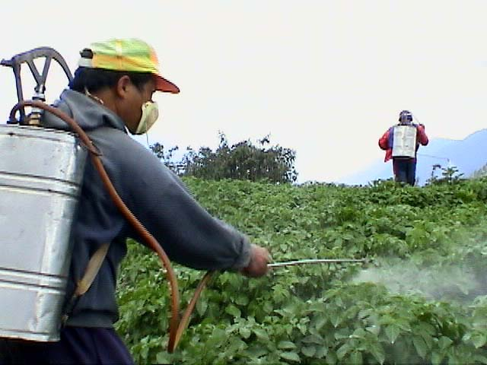
. . . contaminants . . .
Notes:
Here are some of the types of environmental contaminants ELs look for: E coli, Cesium (which is a commonly-found radioactive element) and pesticides.

Slide 31
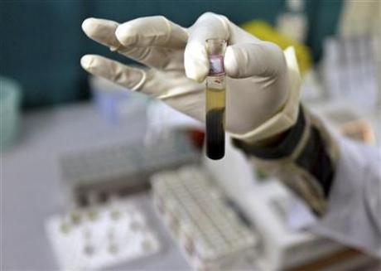
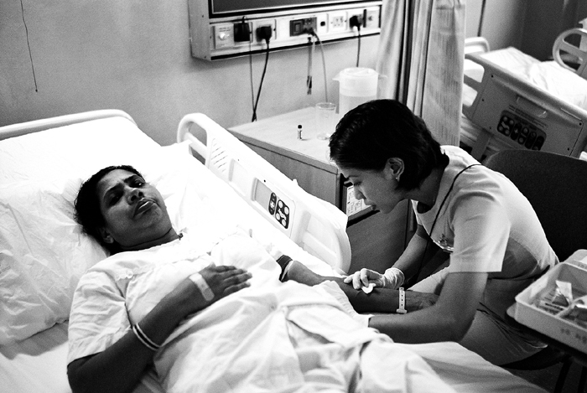
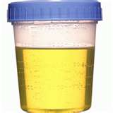
. . .in people. . .
Notes:
Environmental labs look for these contaminants in people (this is what we call biomonitoring)

Slide 32
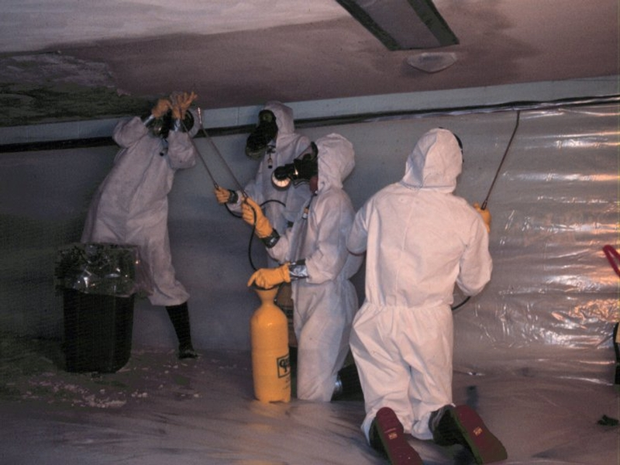
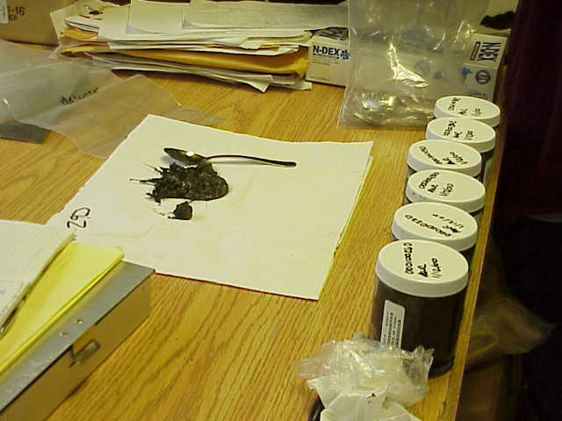
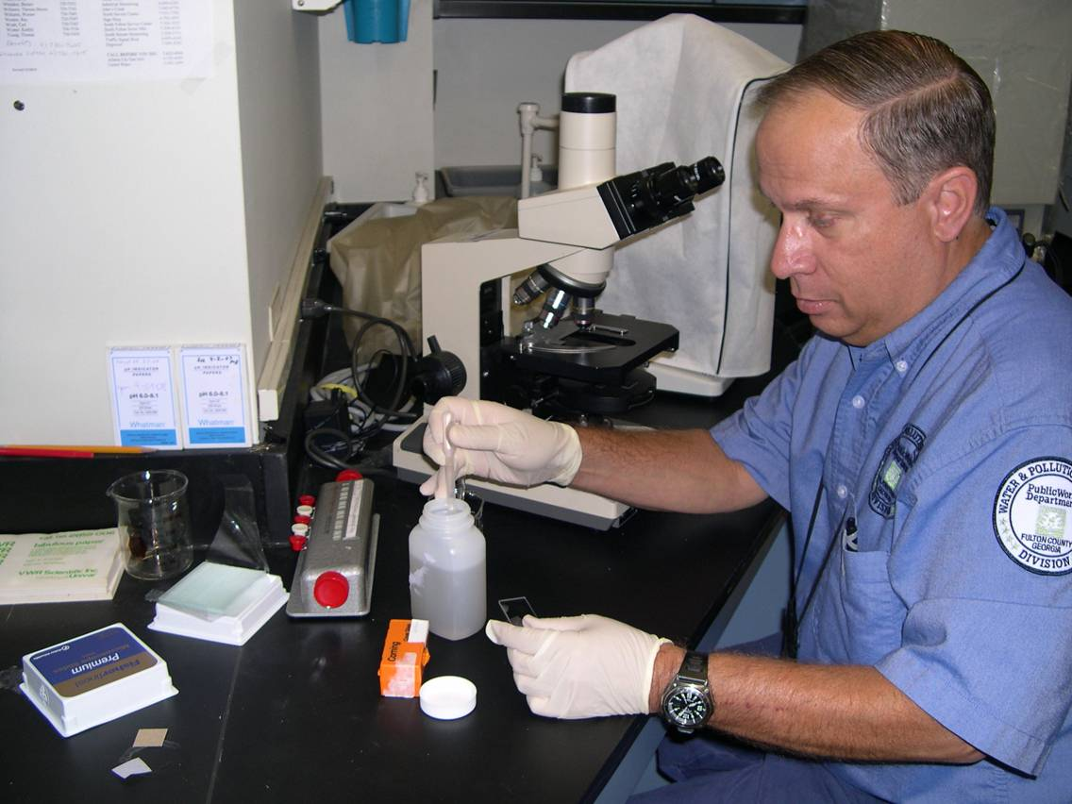
. . . and the environment.
Notes:
And the environment. . .
They:
Analyze air, water, soil, and other environmental samples for potential threats to human health.
Ensure compliance with environmental laws & regulations.

Slide 33
One Way of Estimating Exposure
Air levels
Water levels
Soil/dust levels
Food levels
Nutritional status
Predicted
levels of toxicants
in people
Mathematical
modeling
Lifestyle factors
Personal habits
Genetic factors
Lung, intestine and skin
absorption coefficients
MANY OTHER FACTORS
* Slide adapted from Eric Sampson, CDC
Notes:
1
1
Traditionally we have estimated exposure mathematically, which involves so many factors:
air levels
water levels
soil and dust levels
food levels
Also on here are personal factors such as nutritional status, personal habits and genetic factors.

Slide 34
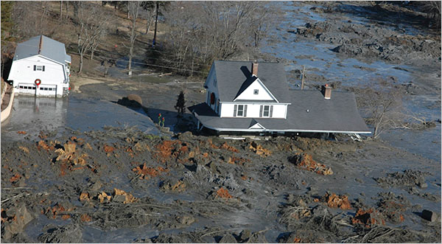
Notes:
The point is everything is a complex mixture.
Pictured here is the coal ash spill that happened in eastern Tennessee in 2008.
Measuring chemicals in air, water, soil, & food doesn’t tell us whether people are actually affected by it or how much.

Slide 35
An Improved Way
Instead of estimating,
measure levels of chemicals in people.
Notes:
2
2
What we really want to know is whether the chemicals got into us, right?

Slide 36
Air levels
* Slide adapted from Tom Burke, Johns Hopkins
Water levels
Soil/dust levels
Food levels
Levels
of pollution
in people
Nutritional status
Lifestyle factors
Personal habits
Genetic factors
Notes:
1
1
The good thing about biomonitoring is that it presents an integrated picture of exposures from all sources: air, water, soil, food.
It also provides indication of how these exposures interact with other factors such as our genes, diet, habits etc.

Slide 37
Notes:
Environmental Working Group presented these statistics two years. . .
The US spent $200M in 2008 monitoring soil for chemicals,
But only spent $13M monitoring people for chemicals
While it is incredibly important to monitor our environment for contamination, we need to ensure that we better understand whether chemicals are actually getting into our bodies, and if so at what level.

Slide 38
Notes:
As I prepared this presentation I tried to get into your heads, and think “what questions might they have?”
One thought was “doesn’t CDC do this? Why would state or local governments need to worry about it?”
CDC’s National Report on Human Exposure to Environmental Chemicals provides estimates of chemical exposures for the US population.
Its current design does not allow calculation of exposure estimates on a state-by-state or city-by-city basis.
Have any of you heard about clusters of disease or environmental concerns near your home?
PHLs can use their already-existing chemistry infrastructure to answer questions for these types of communities.
For example in MA, a student brought mercury to school and potentially exposed hundreds of other students. The MA lab was able to show that none of the children had elevated levels of mercury in their blood, calming fears and reducing the potential cost of clean up.

Slide 39
Notes:
So what are we doing about it? Other than standing here talking to you?
APHL has developed a five year plan to establish a National Biomonitoring Network of public health laboratories.
Such a formal network would allow us to calm citizens’ concerns about local environmental issues while also saving scarce dollars, through increased collaboration and efficiency.
For example, we spend so much money cleaning up hazardous waste sites every year, but biomonitoring may be able to help allocate limited resources toward those chemicals which might be the most important to target.

Slide 40
Notes:
The ability to do biomonitoring already exists in many states due to the Laboratory Response Network.
Originally founded to respond to terrorism, it now is more broadly called upon to respond to any public health threat, whether accidental, natural or intentional.

Slide 41
http://blog.socialight.com/wp-content/uploads/2007/12/tricorder_spock.jpg
Notes:
Which brings me to a related issue. . .field devices. . .
But I’m going to STOP here; I’d like to hear some feedback and see if you have any questions. . .
On to tricorders, oops I mean field devices.
During an emergency, first responders must make rapid decisions to protect their community’s safety as well as their own.
Should they evacuate the area? How many blocks should they evacuate? Should they don protective equipment?
The answers to these questions can make the difference between health and permanent disability, or even death.
The Department of Homeland Security provides funding to first responders for purchase of biological and chemical detection kits and devices to provide fast, accurate identification of the agent.
Unfortunately, many of the claims are untrue—and often, the results are neither accurate nor valid.
Even more troubling, first responders are typically unaware that the kits and devices have limitations.

Slide 42
Notes:
This is a headline from 2008 (happens all the time though)
First responders used a tricorder, I mean field device.
The result insinuated the presence of a non-toxic, inert chemical
Luckily they still sent it to the lab, which identified it as a toxic chemical that could cause illness if inhaled or ingested

Slide 43
Sample Results from IA
 | Team 1 | Team 2* | Team 3*
Cerium Nitrate ~5% Yeast ~5 Methyl Methacrylate ~90% | methyl methacrylate by IR; nothing by raman | tellurium by IR | nitrilotriacetic acid, methyl methacrylate by IR; Organic compound by HazCat
Cesium Nitrate ~3% Yeast ~10% wt/wt Sulfanilamide ~85% | sulfanilamide by both IR and raman | tellurium, tin oxide by IR | sulfanilamide by IR
Ethyl Methyl Phosphonate ~15% Yeast ~15% Penicillin ~70% | no matches | no matches | no matches
* Used no respiratory protection (mask, hood, etc.)
Notes:
IA has a program where they test the ability of the first responders to detect unknowns.
Here are the results of one such test
Methyl methacrylate: fairly toxic, used to make plastics, lightweight and could be disbursed in air using HVAC system.
Yeast tests ability to detect a biological since it contains protein.
Cerium and Cesium aren’t exactly toxic, but a good test if you’re looking for heavy metals.
Sulfanilamide is a common, albeit dated, pharmaceutical.
Penicillin: common pharmaceutical, a light powder out-of-the-bottle, readily-accessible
Ethyl Methyl Phosphonate: precursor and warning sign of a WMD chemical. These compounds affect the nervous systems of all mammals to greater or lesser degrees.
Note that different teams got different results with same instrument . . .need validation, standardization and training!
Emphasizes the importance of a PHL for confirmation.

Slide 44
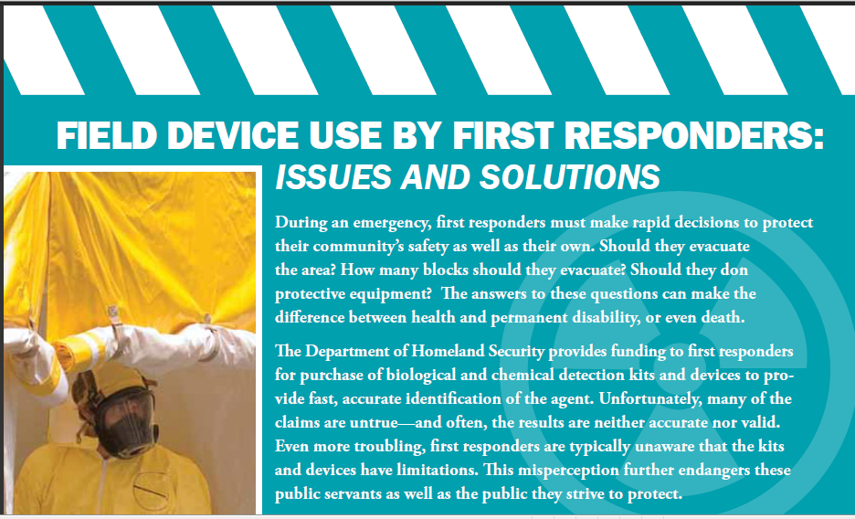
Notes:
And we’re not just whining, we’re offering tangible solutions for how to fix the problem. . .now if only someone who can actually do something about it would listen!

Slide 45
Overview
Public Health Laboratories (PHLs)
Environmental Laboratories
PHLs in Action
Association of Public Health Laboratories
History

Slide 46
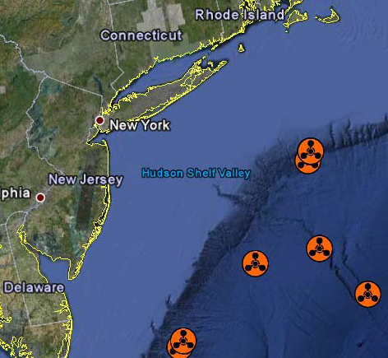
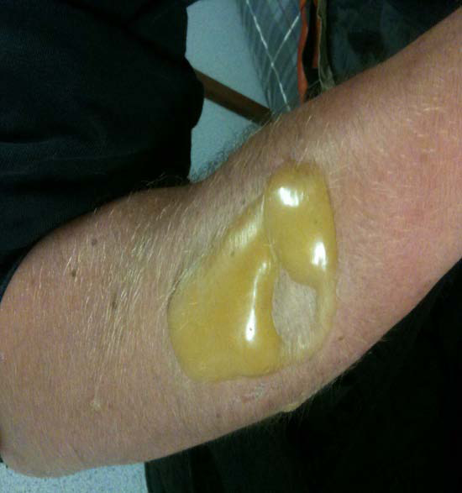
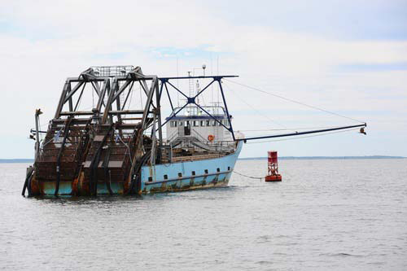
A Fisherman’s Tale
Adapted from Julie Nassif
& Ernest Waterman
Notes:
On June 7, 2010 at 6:30 AM
MA PHL received call regarding possible chemical exposure
A 28 year old male (Patient 1), a commercial fisherman presented @ St. Luke’s Hospital in New Bedford, MA with
Shortness of breath
Erythema
Blisters on forearm and leg
The previous day he had been surf clamming 19 miles off Long Island, NY
They dredged a leaking, torpedo-shaped metal canister along with harvest.
He threw it overboard
Approximately 4 hours later, noticed blisters

Slide 47
Notifications, notifications, notifi…
MDPH Laboratory Director
State Epidemiologist
Director of Environmental Health
Director of Emergency Preparedness
CDC
FBI Weapons of Mass Destruction Coordinator
Poison Control Center

Slide 48
Laboratory Response
Called staff at home & asked them to come in
Coordinated specimen collection & transfer
Set up laboratory for testing
2:00 PM blood and urine specimens arrived
2:30 PM testing began
6:51 PM reported patient results
Clinical data were critical for patient 1 care
Notes:
The laboratory sprang into action
[read slide]
Meanwhile, a second patient presented at St. Luke’s Hospital (Patient 2).
A 33-year old man, a colleague of Patient 1 on the fishing boat.
He reported shortness of breath, itchy skin and “sensation of blisters”
By this time, Patient 1had been transferred to UMASS Medical Center
Patient 1 tested positive for sulfur mustards, negative for lewisites
Patient 2 tested negative for both

Slide 49
Environmental Response
Local fire department
1st National Guard Civil Support Team
US Coast Guard
MA Department of Environmental Protection
US Environmental Protection Agency
Massachusetts HazMat Team
US Navy Explosive Ordinance Disposal
Rhode Island Fire / Hazmat Marine units
Notes:
Even more partners were involved in the environmental response
U.S. Navy Explosive Ordinance Disposal (EOD) - who were immediately called upon to perform the first level A entry (with CST and the RI Marine team) to evaluate the detonators that were brought to the surface during the clam dragging operations with the WWI HD canisters. and
The Rhode Island Fire / Hazmat Marine units who responded with their vessels to provide on-water hazmat response capabilities (it's their boat that is shown on slide 50)

Slide 50
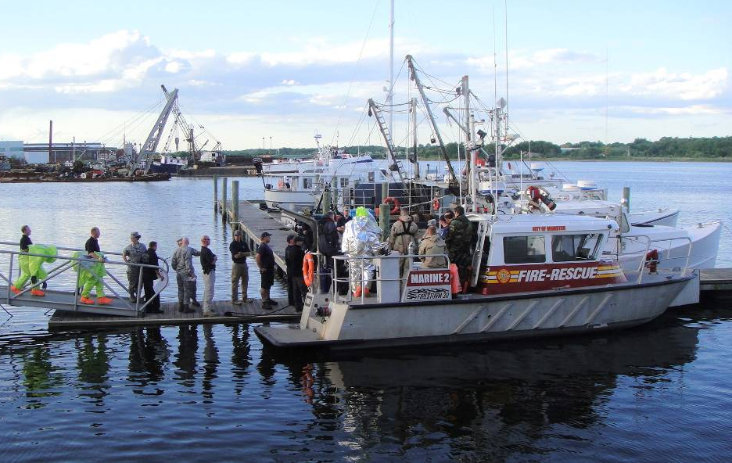
Notes:
The men in space suits could barely fit, there were so many folks involved. . .

Slide 51
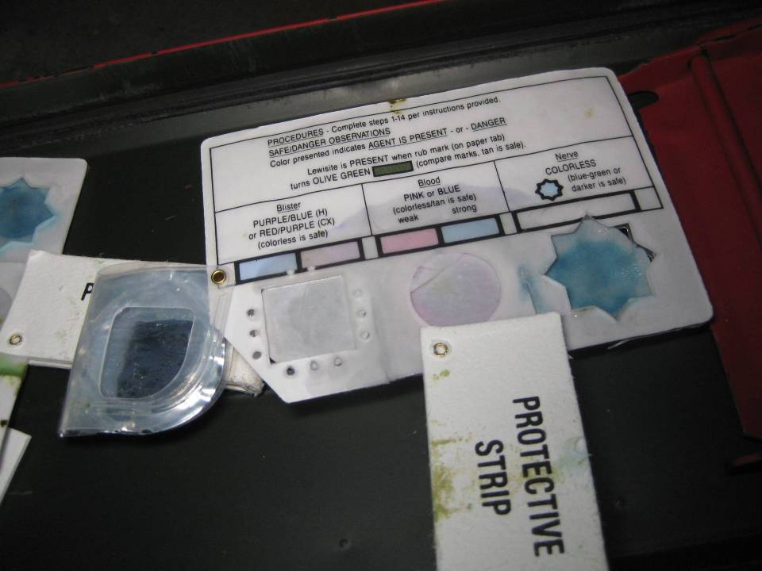
Notes:
About 15 samples taken on the boat and assessed using a kit
They got one blister agent hit on bench in the galley
They got one blood agent hit in the dress-out area, but it was deemed a false positive due to diesel exhaust

Slide 52
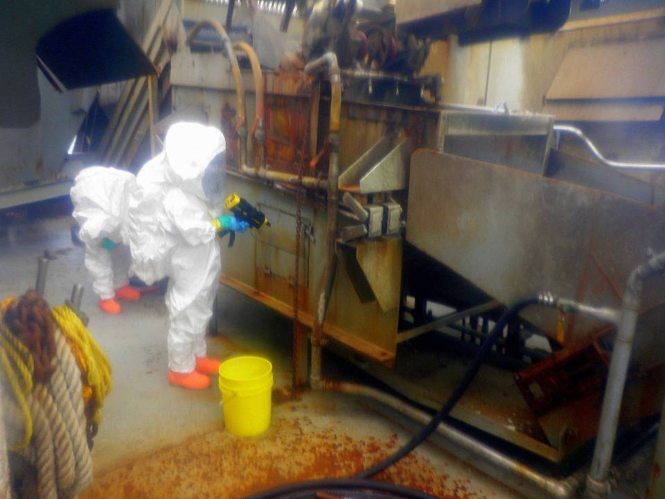
Clearance Sampling
Notes:
Air sampling

Slide 53
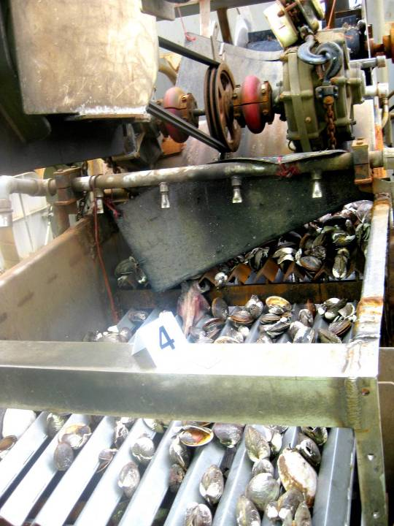
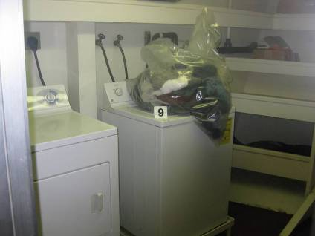
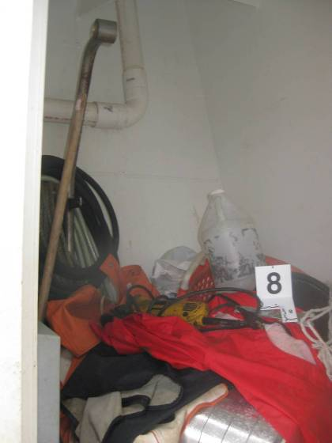
Notes:
Ten (10) wipe samples were also collected

Slide 54
Laboratory Receipt & Screening
Notes:
EPA’s region 1 laboratory accepted all samples through their all hazards receipt facility

Slide 55
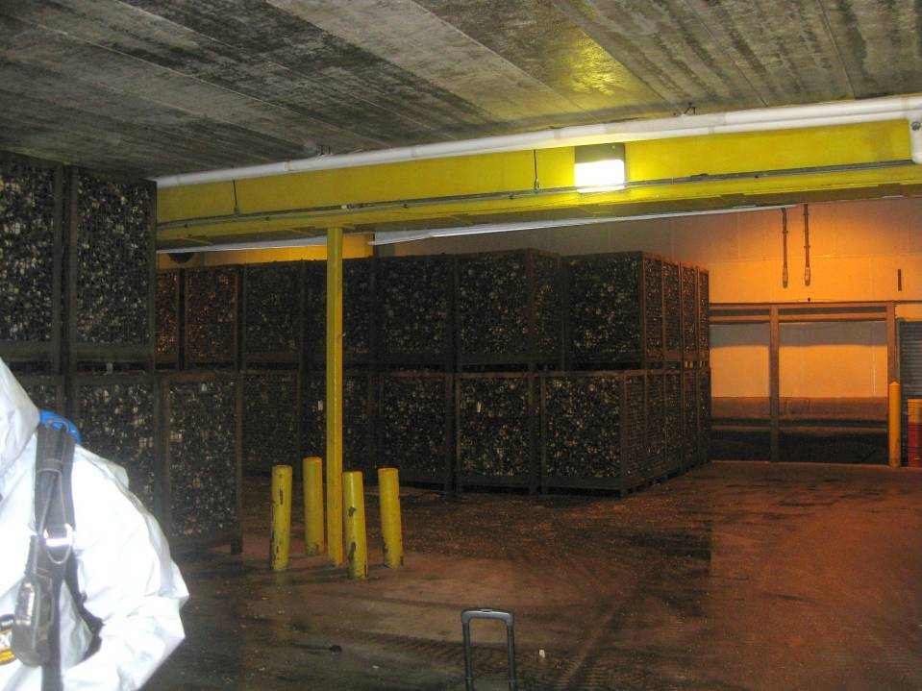
What about all the clams?
Notes:
486, 897 lbs. of clams embargoed
Considered whether testing was a viable option
- But questions remained: what would be the sampling scheme? Who would do the analysis? Would the turn-around time be acceptable?
- Could not design an appropriate sampling algorithm to ensure food safety
Considered disposal mechanisms:
Ocean dumping…but what if someone else dredged them up?
Cannot incinerate haz waste in Massachusetts
- Cannot send it to a landfill in Massachusetts
Ultimately transported to hazardous waste incinerators in Arkansas and Texas

Slide 56
Shipping the Clams
Notes:
Clams repacked into bins lined with layers plastic and sorbent
The trailer bed was also lined
During transfer and subsequent decontamination operations, they monitoring the perimeter air.

Slide 57
Wipe sampling
Notes:
In the warehouse, four samples taken at floor drains and five additional random samples collected.
Wipe samples collected from 10 cm² surface areas on side and bottom of 10% of cages (36 samples)

Slide 58
Air sampling
Notes:
Clam cages and tipper wrapped in plastic

Slide 59
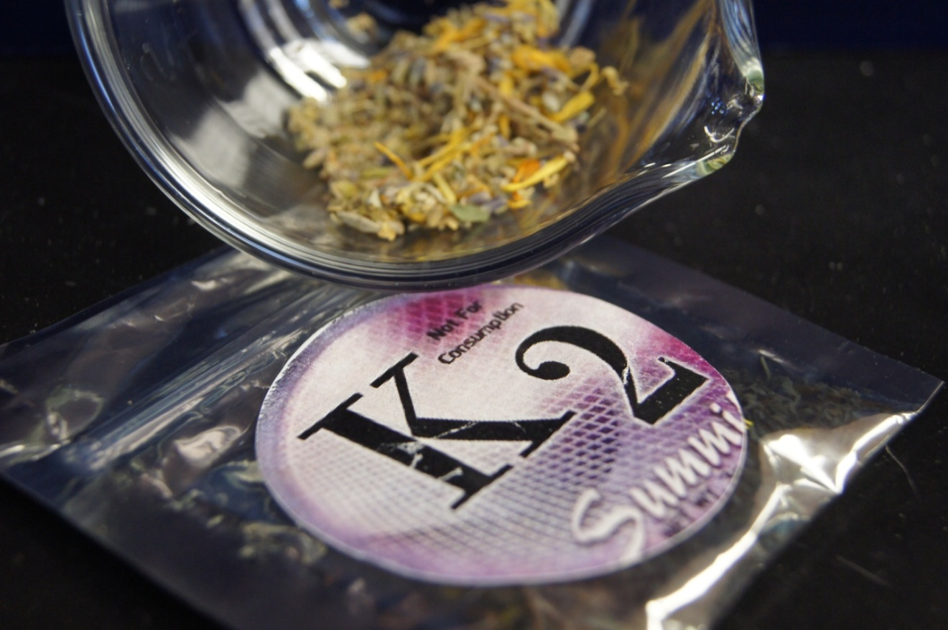
The Two Faces of K2
Adapted from Jeffery Moran
Notes:
Moving on to a second case study. . .
Touted as one of the most dangerous mountains, K2 is the second highest in the world
Only 274 have made it to the summit, but only 254 made it back down
It’s beautiful, it’s a challenge/achievement, it’s facing down death.

Slide 60
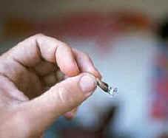
“their effects in humans have not been studied and they could very well have toxic effects.”
– John W. Huffman,
(NY Times 2010)
Notes:
In 1992, John W. Huffman, a Clemson University Chemist, researching the use of THC-like compounds for controlling obesity in mice, synthesized the top two compounds (JWH-018 and JWH-073).
Now street chemists are spraying these compounds on plants used for incense and selling them on the internet or in head shops.
Problems unique to these ‘designer drugs’:
Potency differences
Complex Mixtures
Overdosing

Slide 61
Reasons for K2 Popularity
Pharmacologically active
Legal
Easily produced and distributed
Easily modified to stay in front of regulations
Not detectable on a clinical drug screen!
…Get your weekend high and show up to work on Monday with no worries.
Notes:
[read slide]
Unfortunately it also leads to:
- Memory and learning problems
- Anxiety, panic attacks, extreme agitation, hallucinations, seizures
- Loss of judgment
- Driving impairment
Immunosuppression
People are arriving at emergency rooms with symptoms that would not normally be associated with marijuana
There have been numerous reports of impairment (job and driving) and several suspected death cases

Slide 62
“Where does a parent go to get answers? We talk to our kids about sex.
We talk to our kids about drugs, and we talk to our kids about drinking and being responsible. But how can you talk to your kids about
something you don’t even know about?”
* http://www.nytimes.com/2010/07/11/us/11k2.html
Notes:
In 2008, there were 19 cases nationwide, in 2011 there were over 4000.
[click]
This is a quote from a New York Times interview with Mike Rozga, who said he learned of K2 only after his son’s death.

Slide 63
Arkansas K2 Research Consortium
Statewide Surveillance
K2 Product Testing
Compiling Clinical Data
& Samples
Translational Science
Testing of Human Specimens
State Regulations
Basic Research
Poison Control Center

Slide 64
124 Different Products Submitted
Armageddon
Astral Blast
Blue Fire
Cloud 10
Coma
Demon Ritual Botanical
Funky Green Stuff
Head Trip
Herbal Incense
K2
K2 Blonde
K2 Blue
K2 Blueberry
K2 Cloud 9
K2 Melon
K2 Pink
K2 Summit
K2 Watermelon
K3
K3 Ultimate
Kush
Legal Eagle
Super Kush
Texas Kush
Utopia
Voodoo Spice
Zombie Twilight

Slide 65
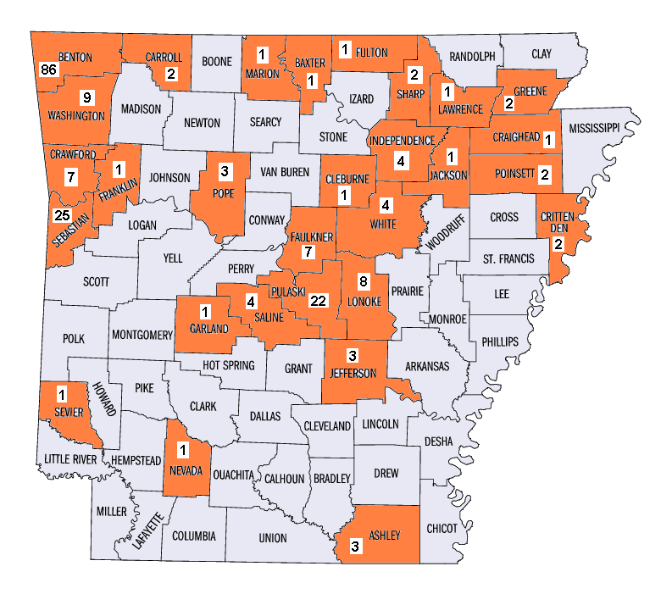
Forensic Surveillance of K2 Cases in AR
Notes:
566 samples (206 cases) March 2010 – October 2011

Slide 66
46 Different Combinations of Compounds
AM2201, JWH-122, JWH-210 (3%)
JWH-250 (3%)
RCS-4 (3%)
JWH-203, JWH-250 (3%)
AM2201 (10%)
AM2201, JWH-210 (5%)
JWH-122, JWH-210 (4%)
JWH-081, JWH-250 (11%)
JWH-018 (14%)
JWH-018, JWH-073 (13%)
Notes:
Shows compounds detected in products collected in Arkansas
Each color on chart represents a unique drug combination

Slide 67
Overview
Public Health Laboratories (PHLs)
Environmental Laboratories
PHLs in Action
Association of Public Health Laboratories
History
Notes:
Now that you know what a “public health lab” is, I can tell you about APHL.
First can someone explain the difference between PH practice (what I’ve been describing) & PH policy?

Slide 68
Public Health Policy is
a course of action: a program of actions adopted by a person, group, or government, or the set of principles on which they are based.*
*Encarta World Encyclopedia
Notes:
I couldn’t find a definition of PH policy but I found one for policy (hopefully you already know what PH is!)
APHL is the national membership organization that represents PHLs.
They work to develop recommendations and guidance for “courses of action” to address public health concerns at the federal, state and community level.
It’s important to understand these differences in the PH field. . .so let’s take a moment here.
Can someone remind me of the difference between academia and practice?
Great – now let’s move on to the policy world.

Slide 69
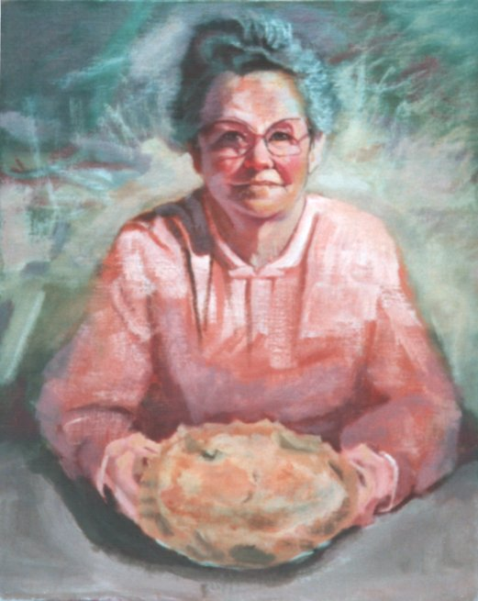
Vision: A healthier world through quality laboratory practice.
Notes:
The association was founded over 50 years ago with the vision of . . .[read slide]
Basically motherhood and apple pie

Slide 70
Mission
To promote the role of public health laboratories in shaping national and global health objectives, and to promote policies, programs, and technologies which assure continuous improvement in the quality of laboratory practice and health outcomes.
Notes:
How do we accomplish that vision? Through the promotion of the role of PHLs. . .[read bold]
Want to pause to add that as you begin your job search, the association world may be one you may not have considered.
There are so many associations in DC, that there is an association of associations.
Have you guys heard of any of these associations or worked with them?
[Many have heard of the American Public Health Association or the American Heart Association]

Slide 71
Notes:
APHL is a national, non-profit, member-driven organization.
~750 members
Local labs
Environmental & agricultural labs
Federal partners
Corporate members
Student members
Note that I said it is a ‘member-driven’ organization.
The membership elects the Board, which oversees the work of staff, member-driven committees and task forces.
Over 80 staff members

Slide 72
Major Committees
Environmental Health
Food Safety
Infectious Diseases
Newborn Screening &Genetics
PH Preparedness &Response
Global Health
Informatics
Knowledge Management
Laboratory Systems &Standards
Membership &Recognition
Public Policy
Workforce
Finance
Notes:
13 committees
+the board of directors = almost 300 members actively involved in the organization
~ 36% of the membership!

Slide 73
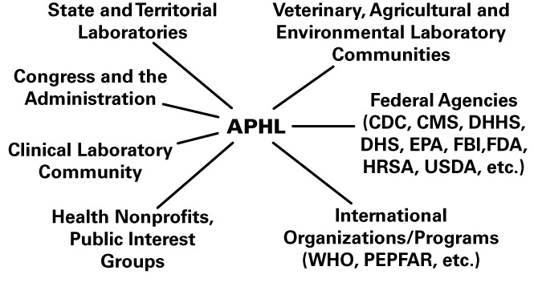
Connections
Notes:
APHL’s most important role is as nexus for communication among diverse constituencies.
The association (refer to graphic):
Connects the 56 state and territorial labs as well as an increasing number of local ones
Links those labs with federal partners such as CDC, EPA, FDA, DHS, FBI, & HRSA
Serves as a nexus between public health and clinical lab communities, such as those in hospitals
Acts as a liaison between public health labs and the companies that supply them with testing materials, instrumentation, facilities and other commercial services.
Advocates for labs with Congress and the Administration. . .

Slide 74
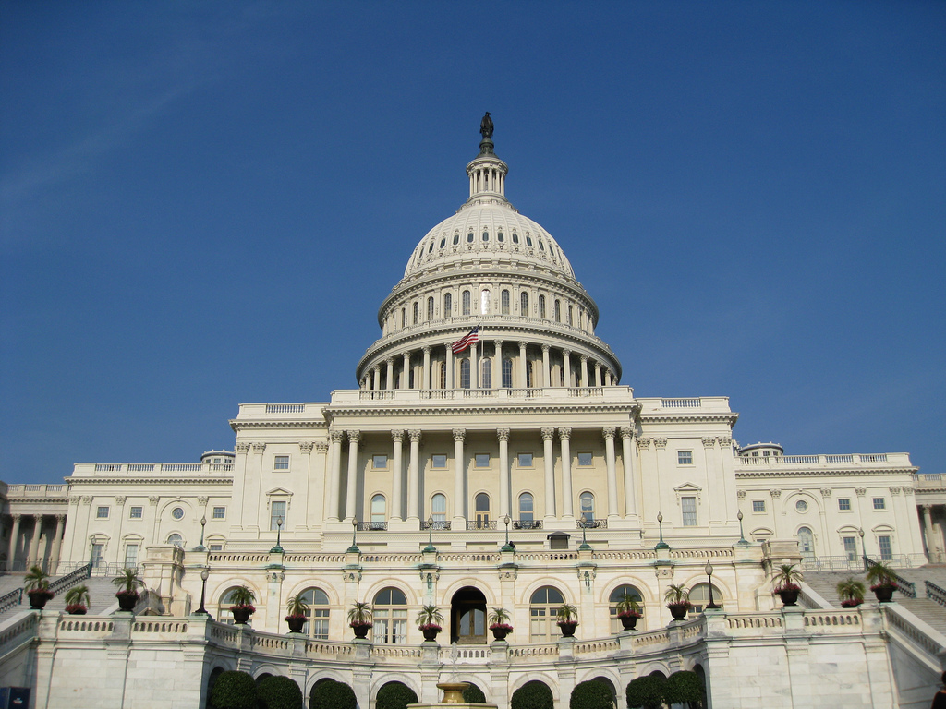
APHL Policy Work
Notes:
Each year set specific policy priorities
Been closely watching the budget conversations
Staff goes up to Capitol Hill with members once a year to meet with their representatives

Slide 75
Notes:
It’s always been hard for public health to hold the spot light despite all of our good work.
It is doubly hard for public health laboratories.
The issues are complicated, not easily digested into sound bites and elevator speeches . . .and laboratorians prefer to DO the good work rather than talk about it.

Slide 76
Notes:
So APHL does a lot of communications such as:
Publications (quarterly magazine, weekly newsletter, issue briefs)
Website
Listservs & Web boards
Press releases
Social Media (we’re on Twitter, Facebook, and LinkedIn) – come find us!
YouTube videos
Blog

Slide 77
Notes:
What are some of our other challenges?
Given the current fiscal climate in states, APHL’s role has become even more important:
As states cut staff, APHL provides fellowships to help meet workforce needs.
As states cut training budgets, APHL provides training scholarships and offer online training.
As states look to improve efficiency, APHL collect success stories and best practices to share.
This shows a map of the states who have completed a voluntary assessment geared toward improving their systems.

Slide 78
Professional Development
Notes:
APHL has four main projects related to professional development:
training in a variety of formats on a variety of topics, such as hands-on training in molecular methods
fellowships
Conferences and meetings
National Center for Public Laboratory Leadership (Focuses on the senior ranks in labs)

Slide 79
PHL Interoperability Project
Notes:
At the national level APHL is working to better connect PHLs electronically with federal agencies and with each other.
Imagine during a Homeland Security incident that laboratories were not able to report their results electronically to EPA or CDC .
Instead they had to manually enter data from the instrument into the computer and then output these results in an Excel spreadsheet.
The results were then emailed or faxed to CDC or EPA.
The federal agencies then had to manually review the data before sharing it with incident response management.
In this age of electronic communication, such stories are more common than not.
Even when laboratory results are communicated electronically, the reporting process may take longer than the actual analysis of the samples.
APHL is working with States to reduce many of these steps, not only during emergencies but on a routine basis.

Slide 80
Global Health
Notes:
APHL also conducts work across the globe.
Work with WHO on a support system for laboratory and surveillance networks.
Provide technical assistance for the development of the Chinese Strategic Plan for their National Infectious Disease Laboratory System.
Pair US PHL Directors with LDs in Ethiopia, Mozambique, Barbados, and Paraguay.
Conduct laboratory “assessments” and training using the Influenza Laboratory Capacity Review Tool in 27 countries.
Helping establish national NBS programs: [training, awareness building, technology transfer] in Ghana, Nigeria, Liberia, Brazil, Ecuador, Tanzania.
Provide a forum for communication among border countries: Canada and Mexican public health laboratories.
Work with Pacific Islands and Caribbean Basin Laboratory Network to assess and develop laboratory capability and capacity.
Do laboratory management training, validate diagnostic testing technologies, plan lab facilities, create strategic plans. . .

Slide 81
Other activities
Information broker
Trend tracking
Technology transfer
Partnership development
Relationship management

Slide 82
Overview
Public Health Laboratories (PHLs)
Environmental Laboratories
PHLs in Action
Association of Public Health Laboratories
History

Slide 83
Notes:
Louis Pasteur provided a major impetus for PHL development in the US.
focused on the causes and prevention of animal diseases such as anthrax and rabies.
in 1885 he saved the life of 9-year-old Joseph Meister who had been bitten by a rabid dog through use of a vaccine.
application of his discoveries brought funding from France and international interest.
U.S. medical universities and state/large city health departments wanted to provide similar services.
In the US, academic laboratories started springing up.
1884: Carnegie Laboratory at the Bellevue Hospital Medical College
1886: NYU
1889: Univ. of Michigan
1893: Hopkins Medical School
They were also co-located with state and city DOHs, e.g., Massachusetts, Providence RI and NYC (1886-1894)
The early days saw a strong desire to rapidly apply laboratory findings to treatment and prevention.
PHLs often produced both vaccines and antisera and brought it to the hospitals for use.

Slide 84
Developing the federal system
Notes:
Epidemics of contagious diseases continued to kill many, spread fear and panic, and disrupt government.
Smallpox, yellow fever, diphtheria and cholera caused outbreaks that decimated communities.
Thisis a hospital ward filled with cholera patients, few of whom would survive.
In 1887, the National Hygienic Laboratory was created as part of the Marine Hospital Service – it was the forerunner of the NIH.
By 1902 diphtheria and tetanus antitoxins and smallpox vaccine were on the market; Congress charged this lab with testing and regulating.
In 1906, Congress passed the Pure Food and Drug Act and the Bureau of Chemistry was created in the Dept of Agriculture
In 1912, Public Health Service was created.
In 1946, CDC was established.
1950s widespread fear of biological warfare
Epidemiologic Intelligence Service established at CDC
laboratory capability linked to surveillance

Slide 85
From the early days to today
Notes:
PHLs remain an essential component of the infrastructure for disease treatment and prevention.
The big difference is that they are not typically seen as the heroes who make ground-breaking discoveries.
Occasionally, health threats & outbreaks rise to a level of concern among the public, politicians and scientists, emphasizing the importance of PHL
outbreak of polio caused by a vaccine
1957 flu epidemic in which typing enabled production of more effective vaccines.
1980s awareness of value of collaboration grew between laboratorians and epidemiologists
Legionnaire’s Disease
Toxic shock syndrome
Removal of lead from gasoline
HIV/AIDS
Food-borne illnesses
Newborn screening
PHLs are drawn more and more into global health because of the ease of international travel, globalization of the economy (especially foods) and the fact that an infected person doesn’t always show symptoms as they come through an airport or port but can end up anywhere in the US.
Malaria & smallpox eradication
Identification of Ebola virus & SARS virus

Slide 86
roughly 10 billion lab tests are performed annually & demand is expected to climb
U.S. Bureau of Labor Statistics ~2005

Slide 87
Top 5 Challenges Today
5. Workforce
4. Bureaucracy
3. Image
2. National voice
1. Budget

Slide 88
Notes:
Workforce issues are particularly relevant to you!
On December 6, 2010 U.S. News & World Report released their ranking of the top fifty careers of 2011.
To make the cut, job growth had to be at an above-average rate over the next decade and provide an above-average median income. Job satisfaction, turnover, and impending retirements were also considered.
When all of those were taken into consideration, Laboratory Technician finished as one of the best careers for 2011!
Calling laboratory technicians and technologists the “unsung heroes of the healthcare industry,” jobs in this field are expected to grow 16% between 2008 and 2018.
This means an additional 25,000 jobs, not including positions due to retirements and turnover.

Slide 89
“Take interest, I implore you, in those sacred dwellings which are designated by the expressive term: laboratories. Demand that they be multiplied; that they be adorned. These are the temples of the future…temples of well being and happiness. There it is that humanity grows greater, stronger, better.”
Louis Pasteur

Slide 90
Take-Away Messages
PHLs keep our population healthy and productive.
Environmental labs are integral to exposure assessment.
Measure chemicals in people
Measure chemicals in the environment
Consider a job in labs or the association world.
Beware of tricorders.
Notes:
Before I tell you what I hope you take away from this presentation. . .I’d like to ask what you think were some of the most salient messages.
We’ll see how well I did. . .
Any takers?
Well, here is what I hope you will take away:
[read slide]

Slide 91
Acknowledgments
Megan Latshaw, Scott Becker, Karen Breckenridge, Ralph Timperi, Rosemary Humes, Patina Gagne, Chris Mangal (APHL)
Ernest Waterman, EPA Region 1 Laboratory
Julianne Nassif, William A. Hinton State Laboratory Institute
Jeffery Moran, Arkansas Public Health Laboratory
Laboratory Directors in LA, MD, OH, TX, ME, UT, CO
[add name of the teacher or professor who invited you]

Slide 92
Connect
LabLog
http://blog.aphl.org/
http://www.facebook.com/PublicHealthLabs
http://twitter.com/aphlnews
http://www.linkedin.com/company/54323
http://www.youtube.com/user/aphlvideo
Notes:
Thank you for your attention!
I’m open to questions, suggestions & anything else you want to bring up. . .

Slide 93
Evaluation
What did you like most about the presentation?
What did you like least about the presentation?
Any suggestions or comments?

